Slide 1
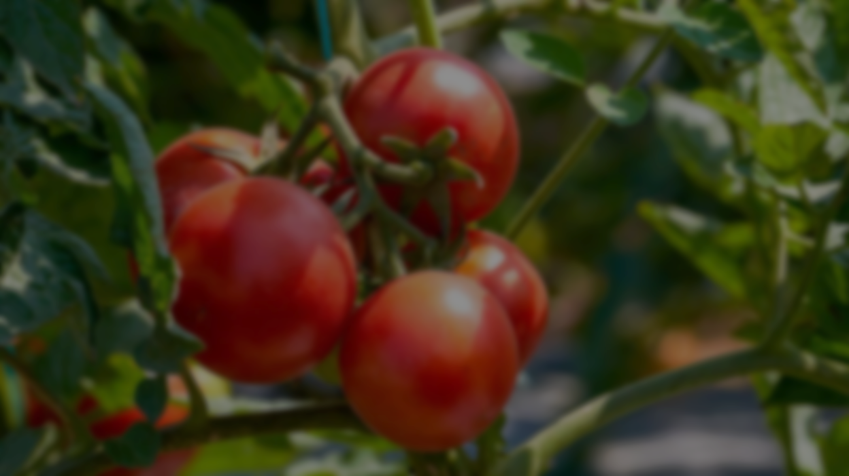
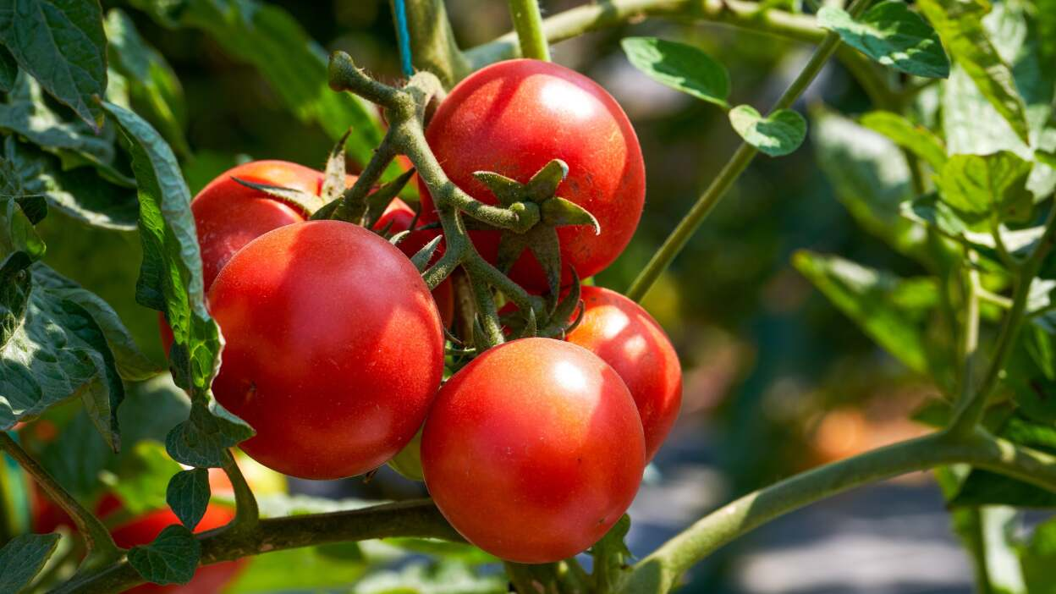
Revolutionizing Tomato Production
and quality assessment using AI
24-25J-337

Slide 2
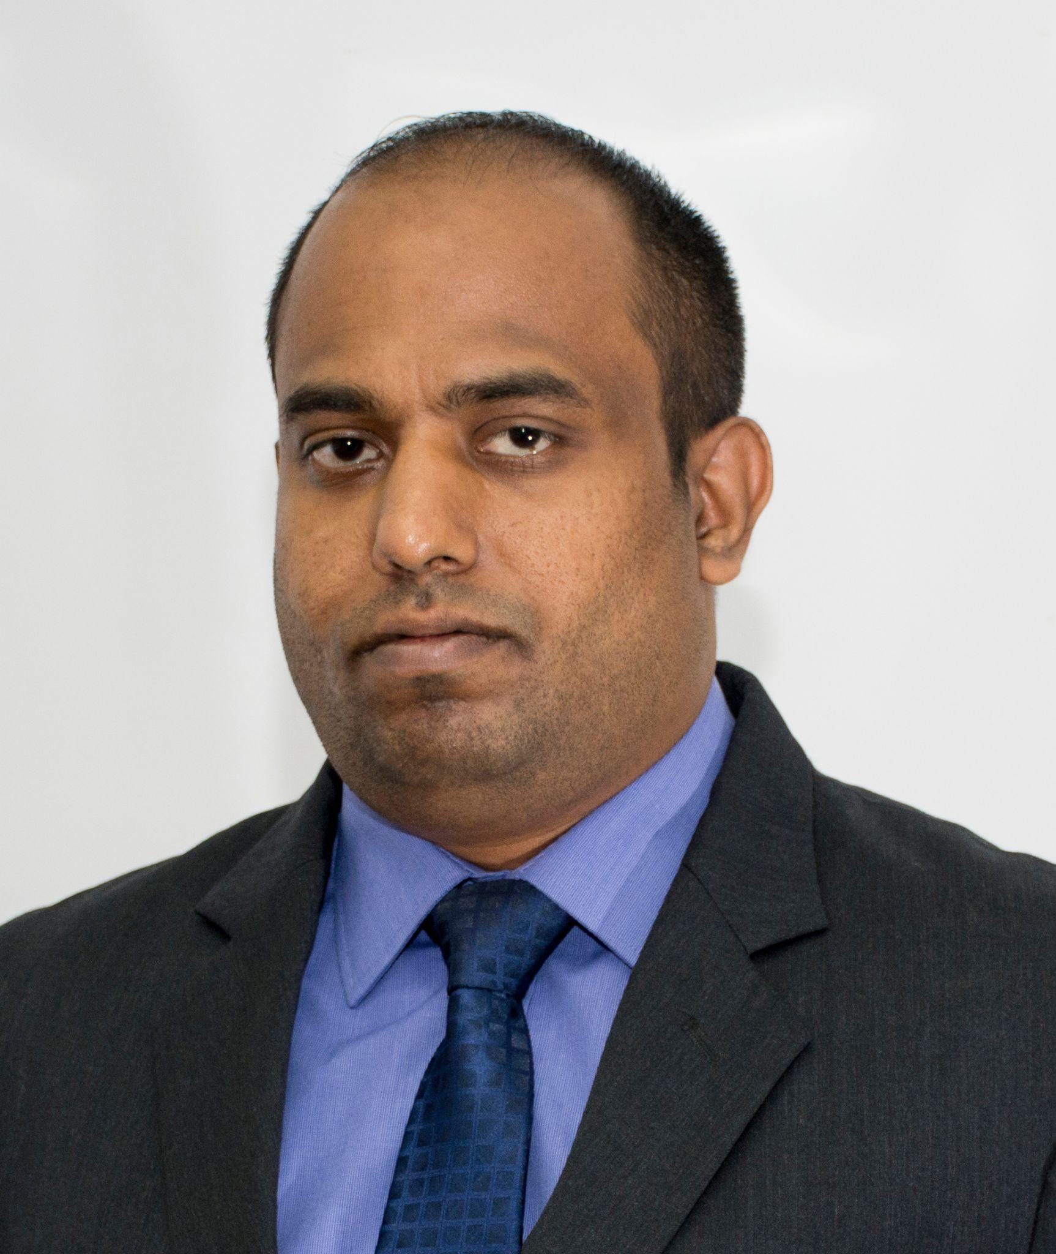
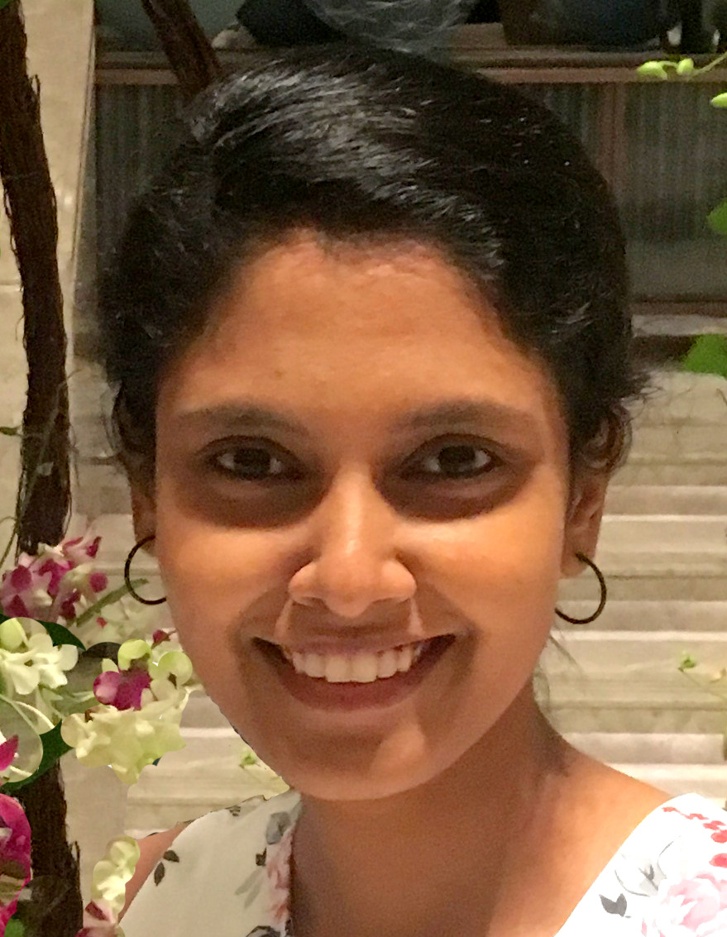
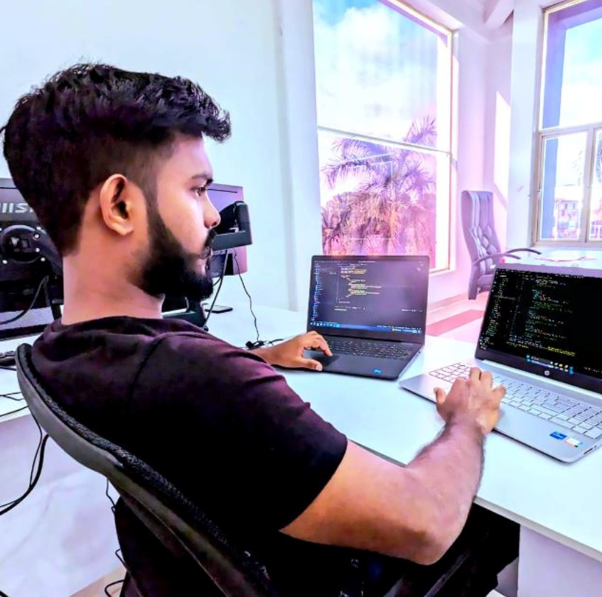
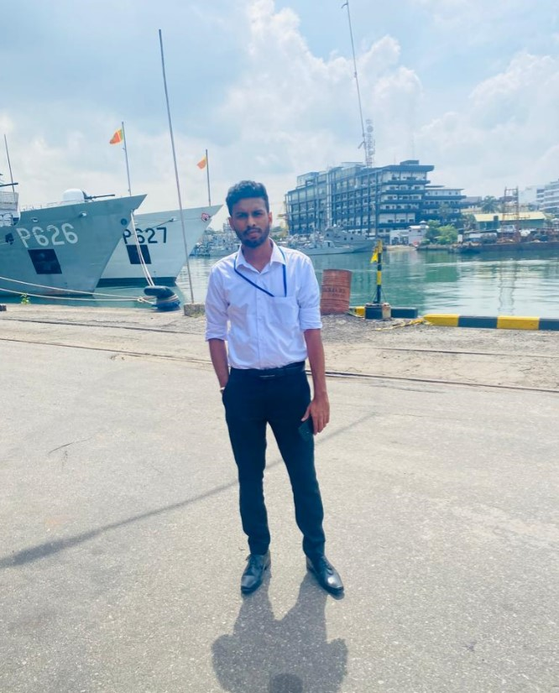
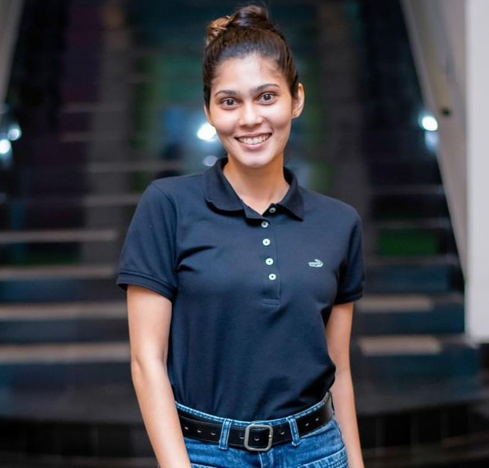
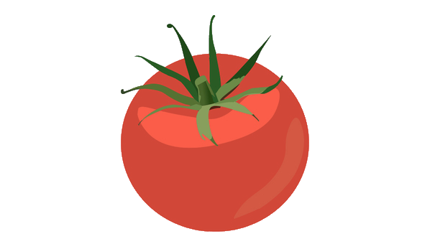
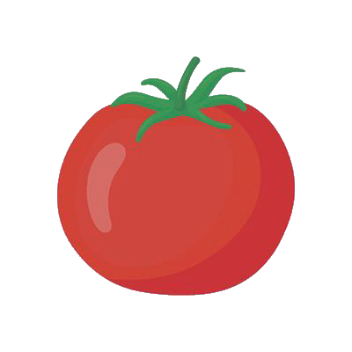
Our Team
Mr. Amila Senarathne
Supervisor
Dr. Lakmini Abeywardhana
Co-Supervisor
IT 20142728
Ranawaka. T. D
IT 21013164
G. D. M. J Samarasinghe
IT 20665548
Herath H.M.R.K

Slide 3

Introduction
Our project aims to create an AI-driven system for tomato cultivation for precise agriculture.
Key areas that our project address are inconsistent ripeness identification, manual quality grading and delayed disease detection.
The goal is to improve productivity, reduce waste, and empower farmers with a reliable tool for optimizing tomato farming practices.
Group ID 24-25J-337

Slide 4
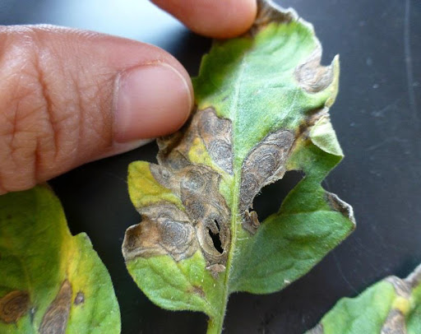
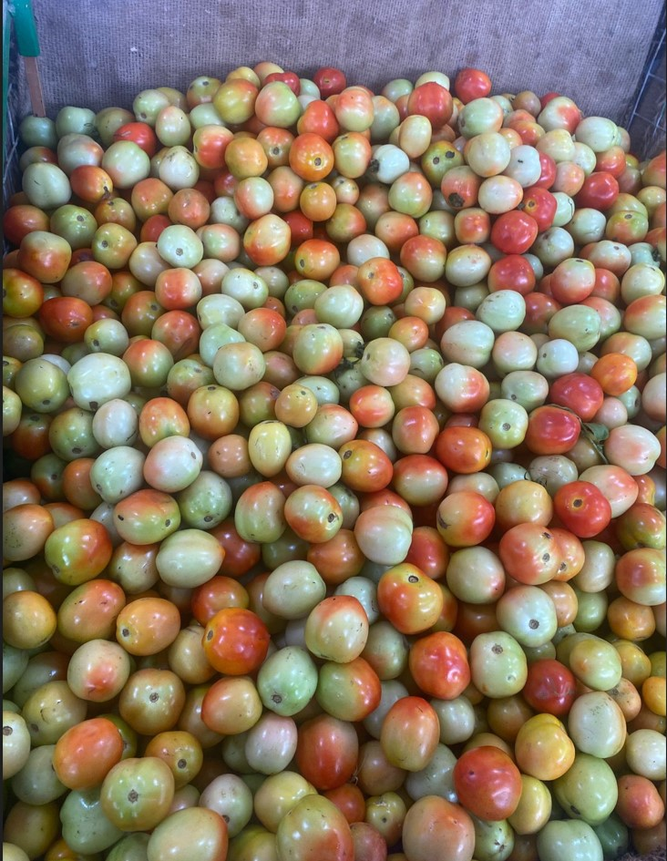
Research Problem.
Inconsistent Ripeness Detection in Tomato Harvesting
Manual and Inaccurate Tomato Quality Grading
Delayed and Inefficient Disease Identification
Limited Access to Data-Driven Insights
Group ID 24-25J-337

Slide 5
Objectives
Ripeness Detection and Harvest Prediction
Defect Detection and Quality Grading
Disease Detection and Severity Analysis
Group ID 24-25J-337

Slide 6
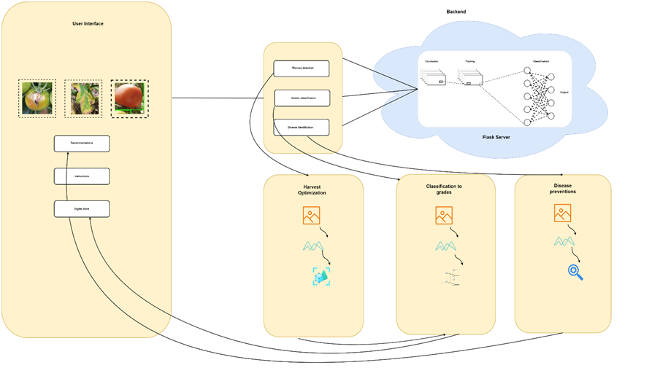
System Diagram

Slide 7
IT 21013164| Samarasinghe G.D.M.J
BSc. (Hons) Degree in Information Technology Specialization in Information Technology
IT 21013164| Samarasinghe G.D.M.J| 24-25J-377

Slide 8
Research Gap
To keep agricultural goods of high quality and market value, it is essential to prevent post-harvest losses.
Harvesting tomatoes at the right ripeness ensures optimal flavor and quality, enhancing marketability and reducing waste
Identifying ripeness stages is crucial for timing tomato harvests to ensure peak quality and market appeal.
IT 21013164|Samarasinghe G.D.M.J| 24-25J-377

Slide 9

Research Problem
Tomatoes that are harvested too early or too late will have lesser revenue due to decreased market value, therefore choosing the best harvest time is crucial for maximising quality and profitability.
IT 21013164|Samarasinghe G.D.M.J| 24-25J-377

Slide 10
Comparison
Features | Proposed Mobile Application | Other apps
Mobile App | ✅ | ✅
Input Image | ✅ | ❌
Identify Harvesting Time | ✅ | ❌
Identify Tomato Stages | ✅ | ❌
Focused Content | ✅ | ❌
Device Compatibility | IOS / Android | Android
IT 21013164|Samarasinghe G.D.M.J| 24-25J-377

Slide 11
Specific and Sub Objectives
Main Objective
Develop a mobile application to identify the best time to harvest tomatoes.
As well as the stages of ripeness and the time period during which they should be harvested.
Sub Objective
Create user friendly
Interactive mobile application
limited resource utilization
Add real time images to recognize tomatoes ripeness stages and harvesting time
IT 21013164|Samarasinghe G.D.M.J| 24-25J-377

Slide 12
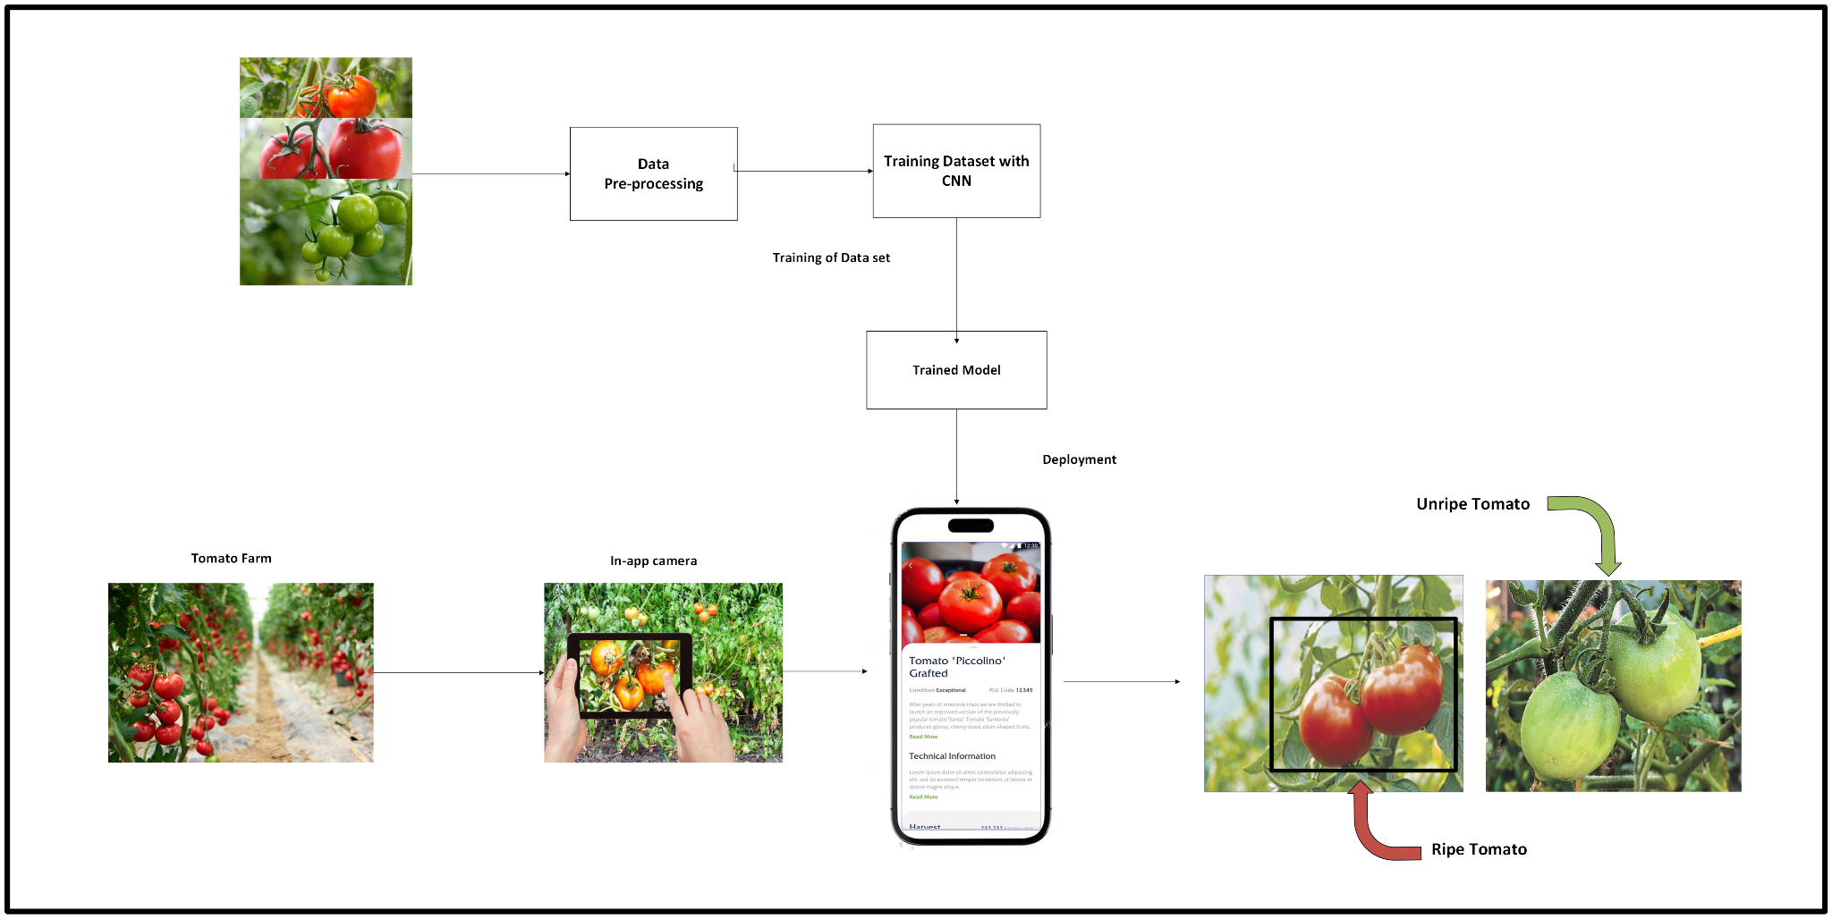
System Overview
IT 21013164|Samarasinghe G.D.M.J| 24-25J-377

Slide 13

Completed Tasks
Finding an appropriate dataset
Completing the test model using test data obtained
Train the ML model using the dataset
Identifying the criteria for selecting
Developing mobile App

Slide 14
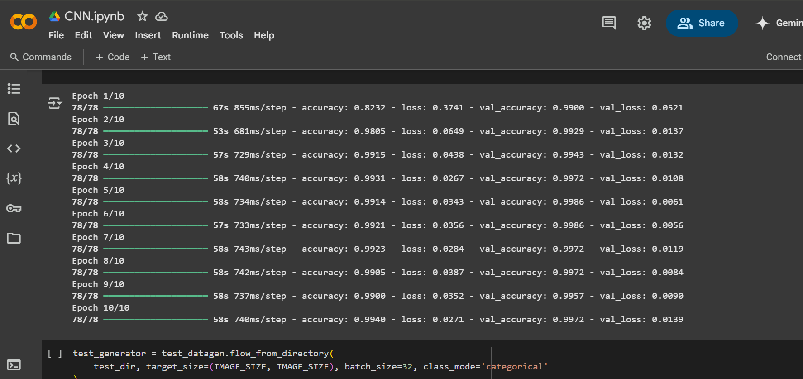
Evidences for the completion
Model training

Slide 15
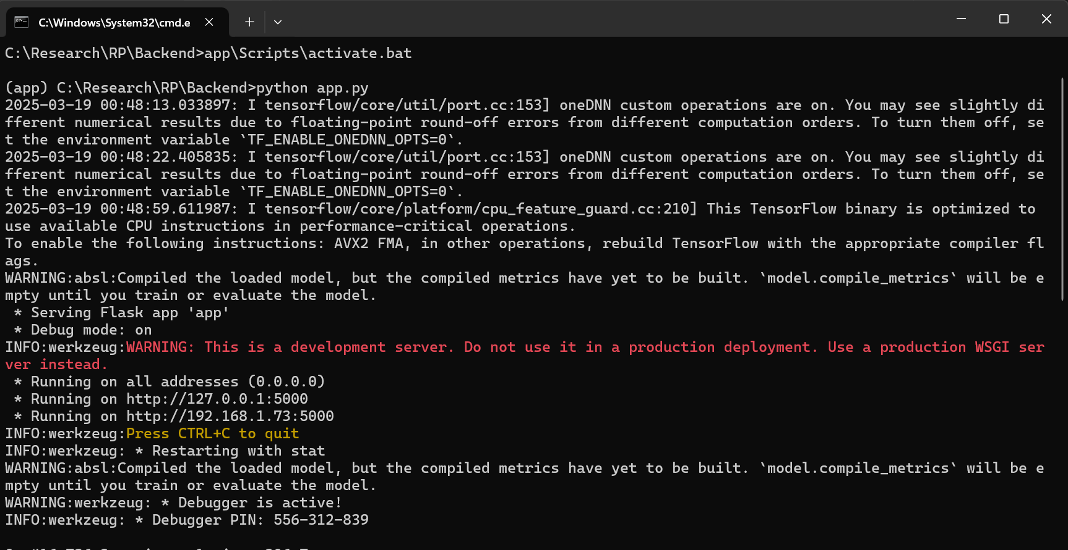
Evidences for the completion
Backend Running Stage

Slide 16
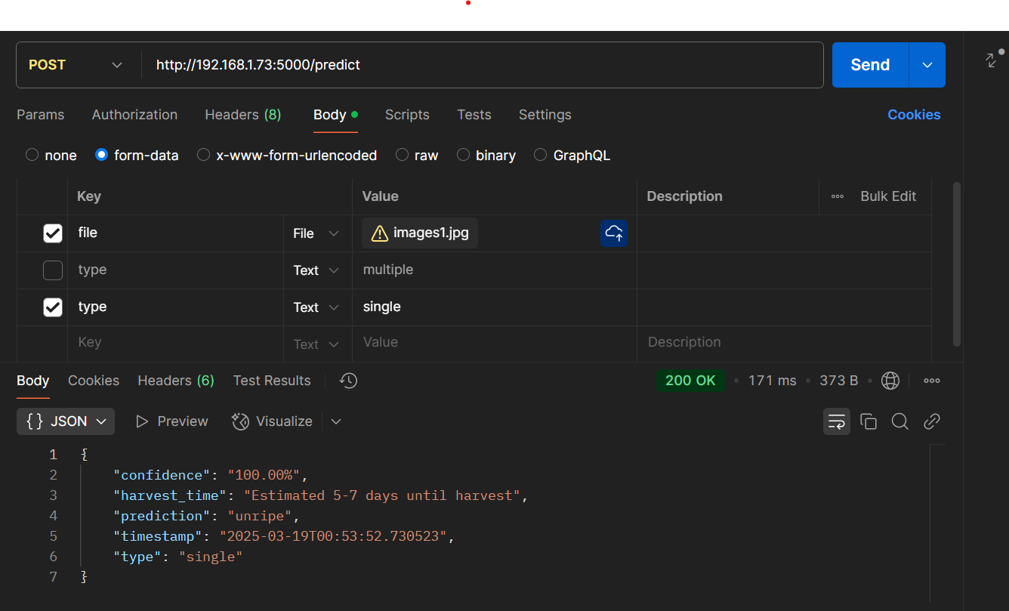
Evidences for the completion
CNN model

Slide 17
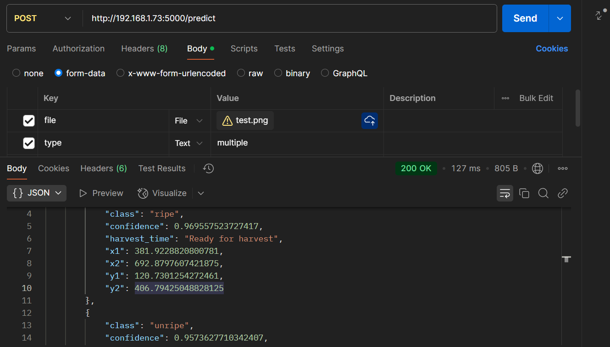
Evidences for the completion
Yolov8 model

Slide 18
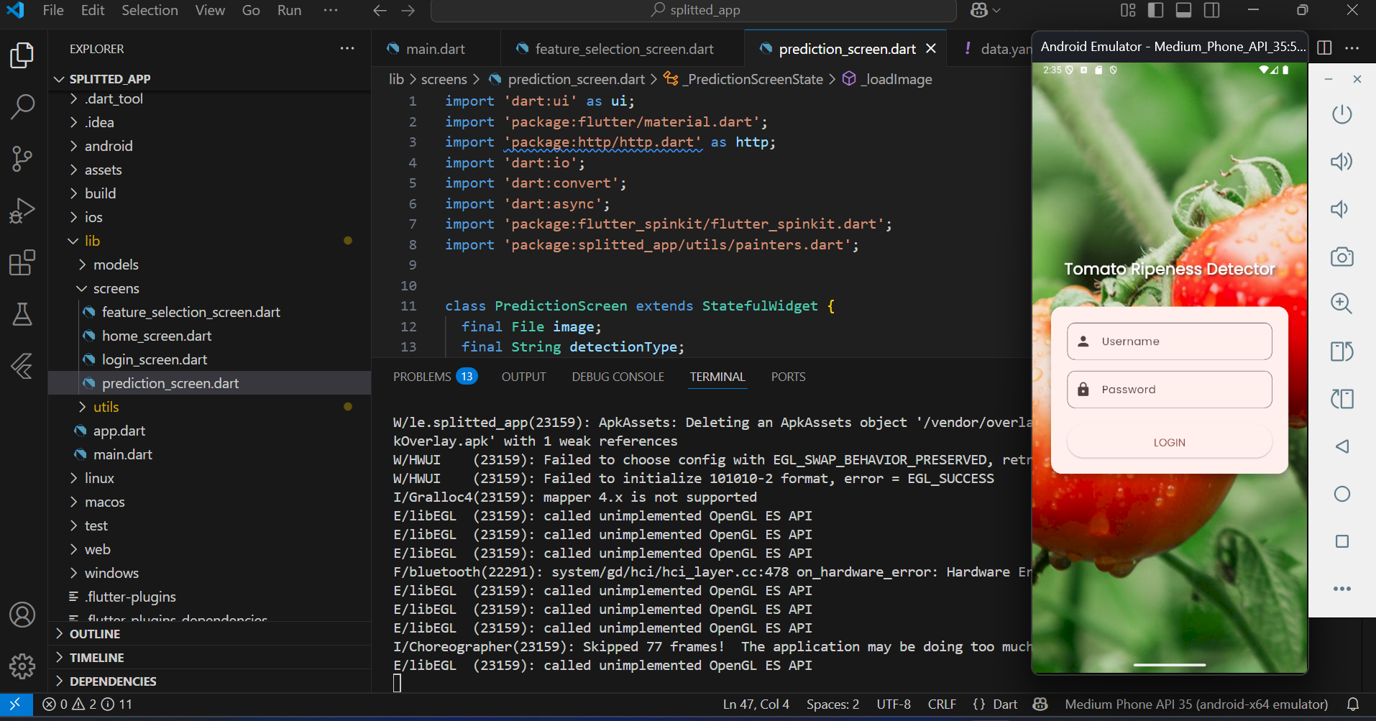
Evidences for the completion
app running stage

Slide 19
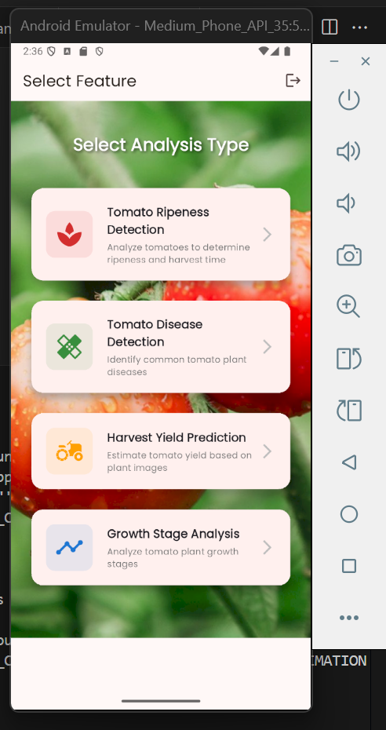
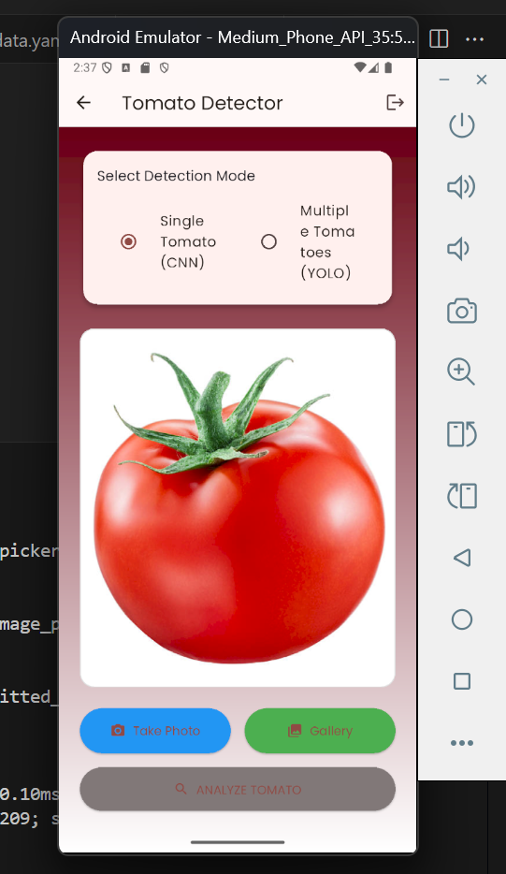
Evidences for the completion
2 page
3 page

Slide 20
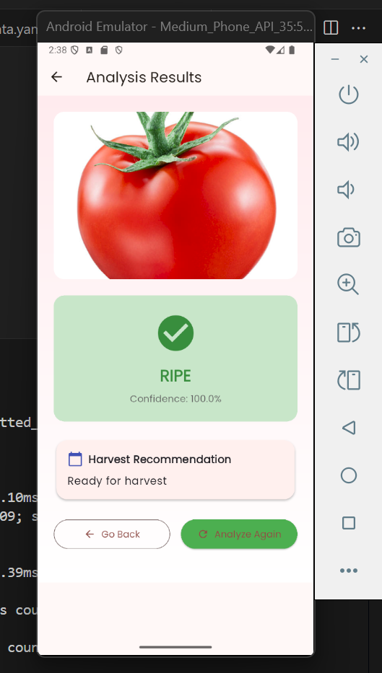
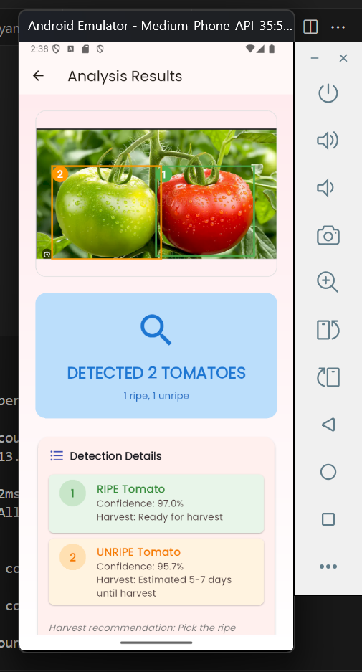
Evidences for the completion
4 page
5 page

Slide 21
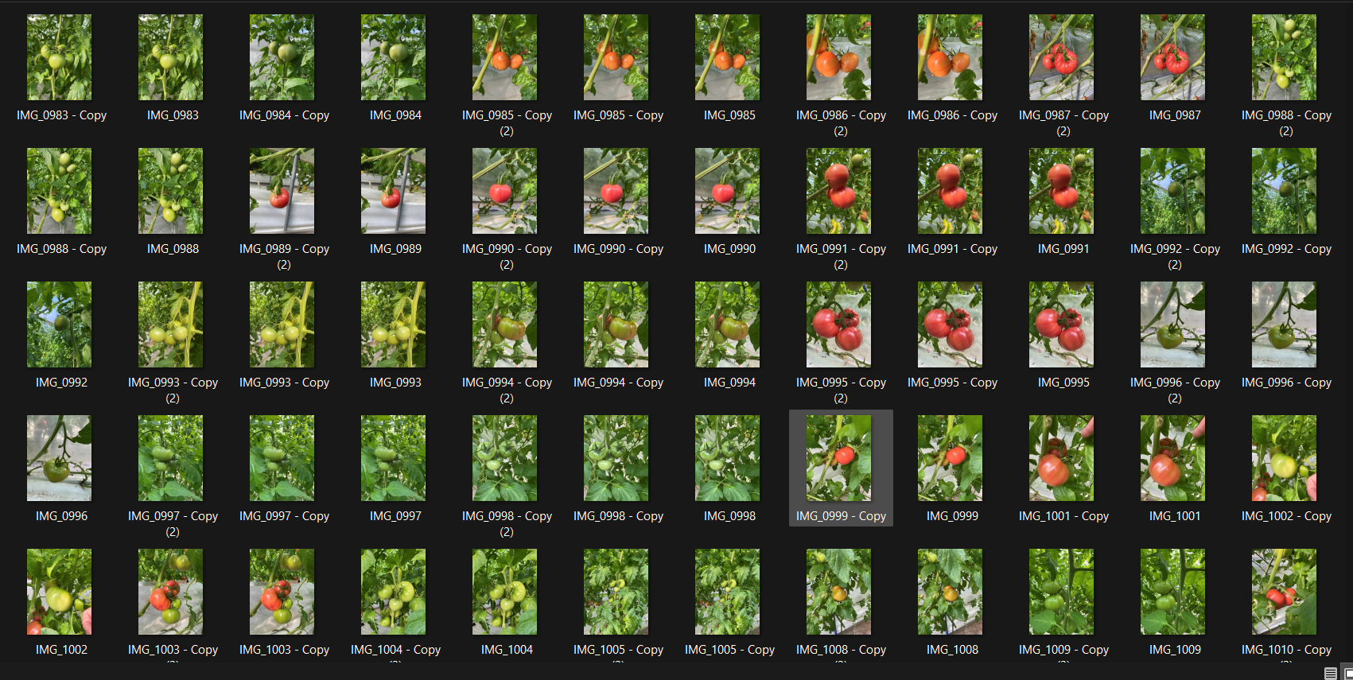
Evidences for the completion
Dataset train folder (876 images)

Slide 22
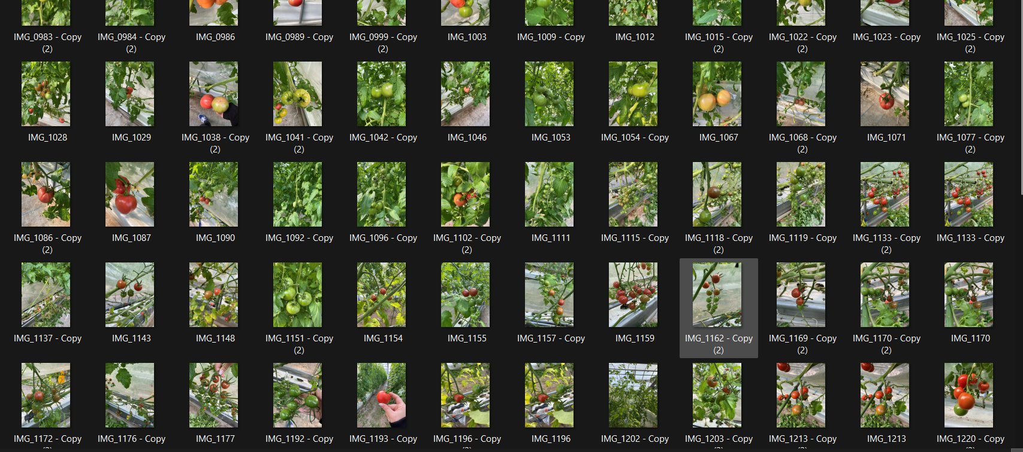
Evidences for the completion
Dataset validation (109 images)

Slide 23
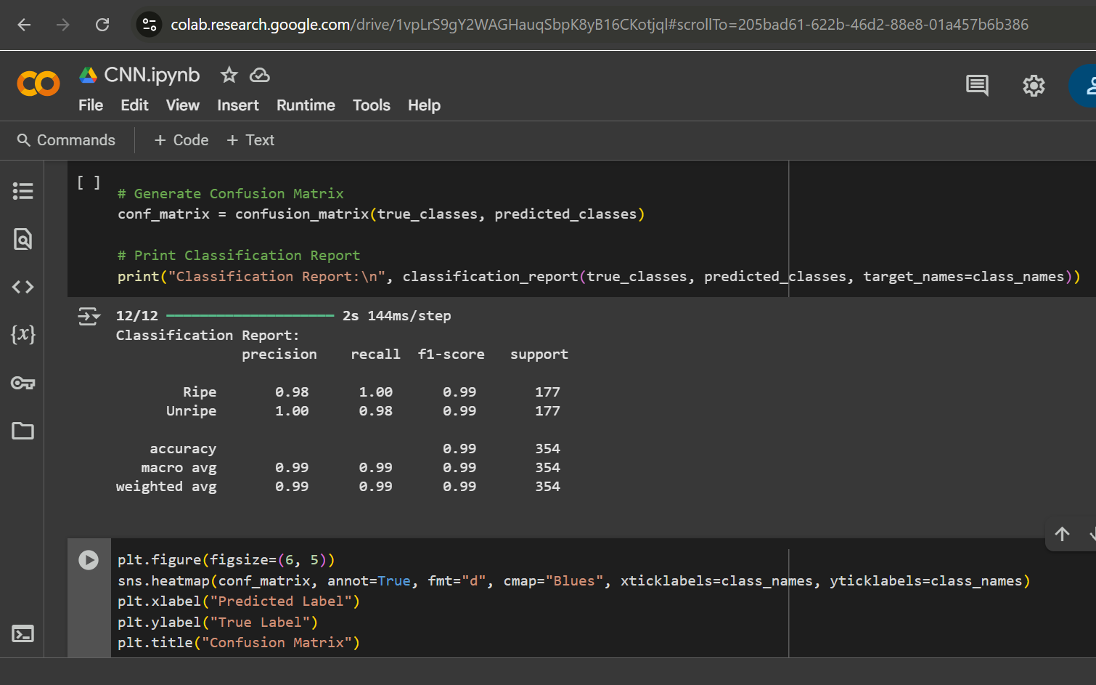
Evidences for the completion
CNN Precision of dataset

Slide 24
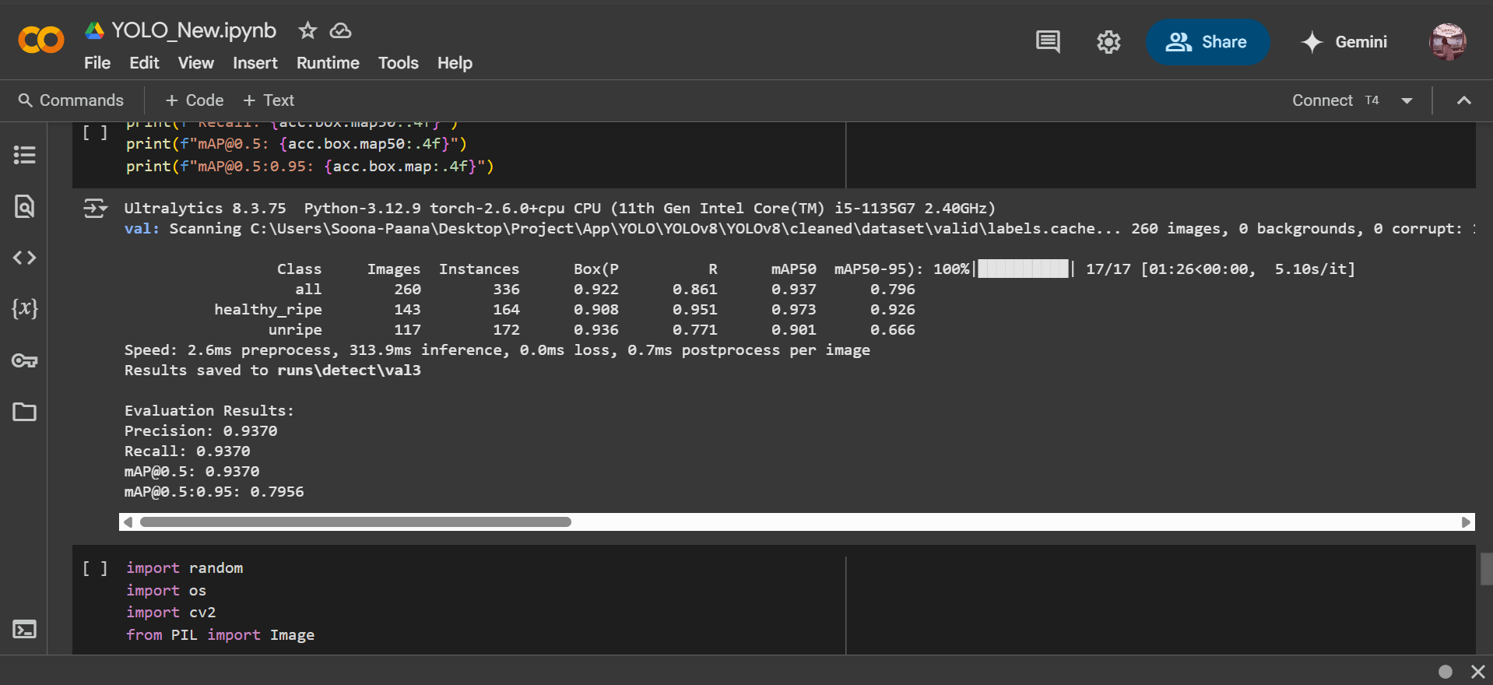
Evidences for the completion
Yolo V8 Precision of dataset

Slide 25
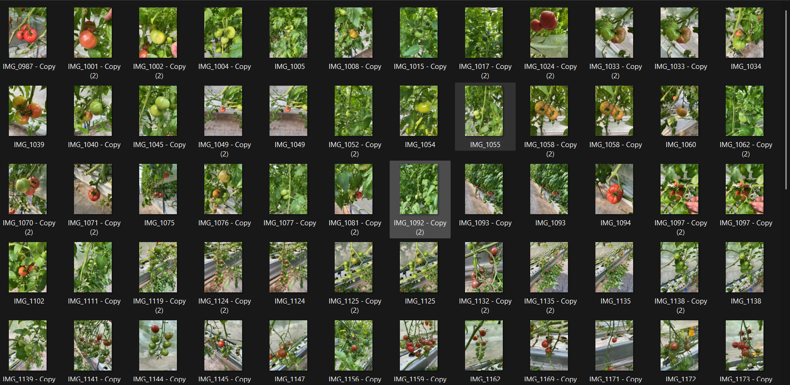
Evidences for the completion
Dataset testing (110 images)

Slide 26
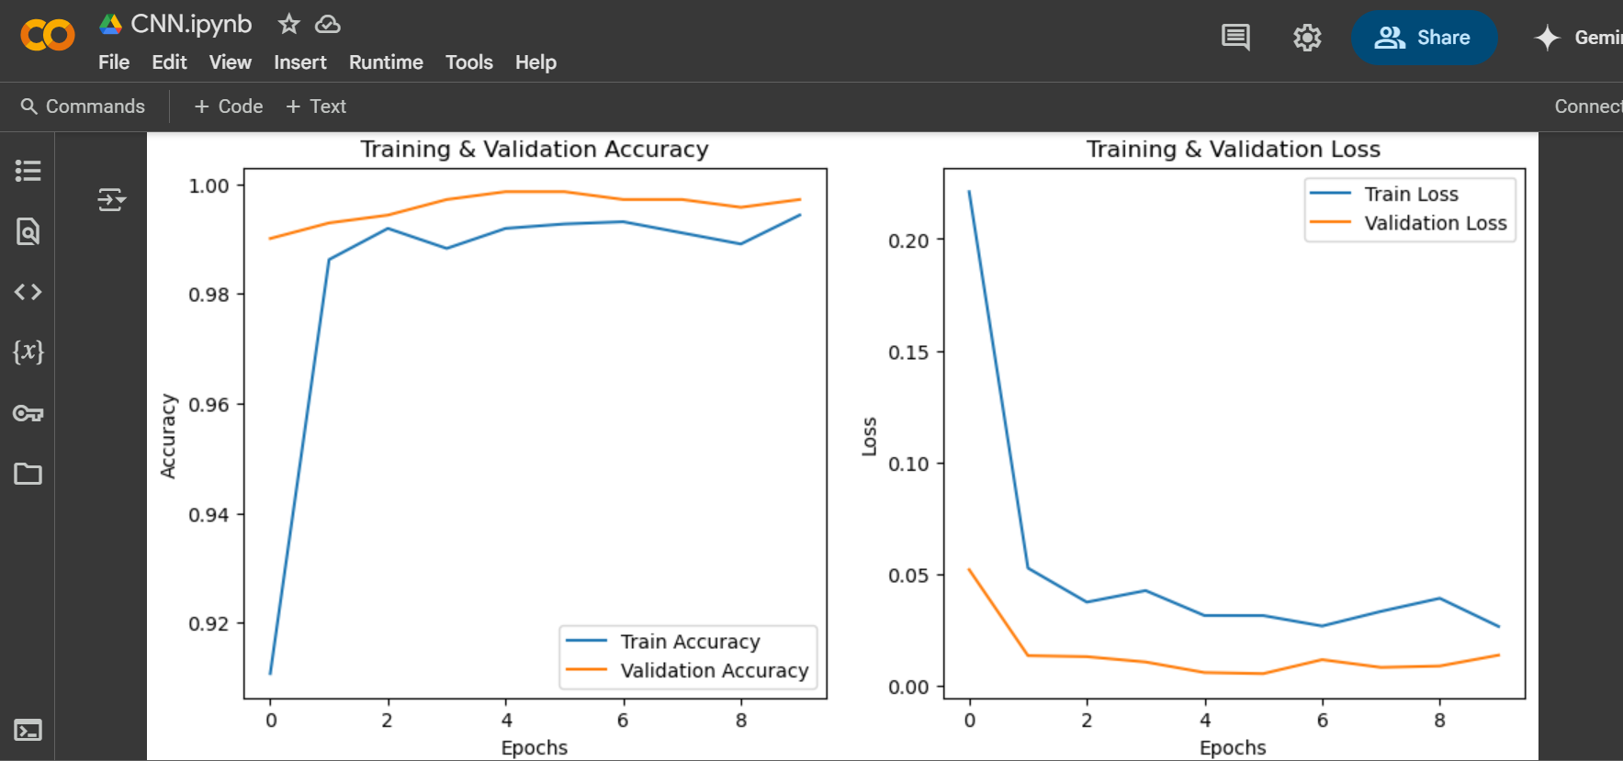
Evidences for the completion
CNN training & Validation

Slide 27
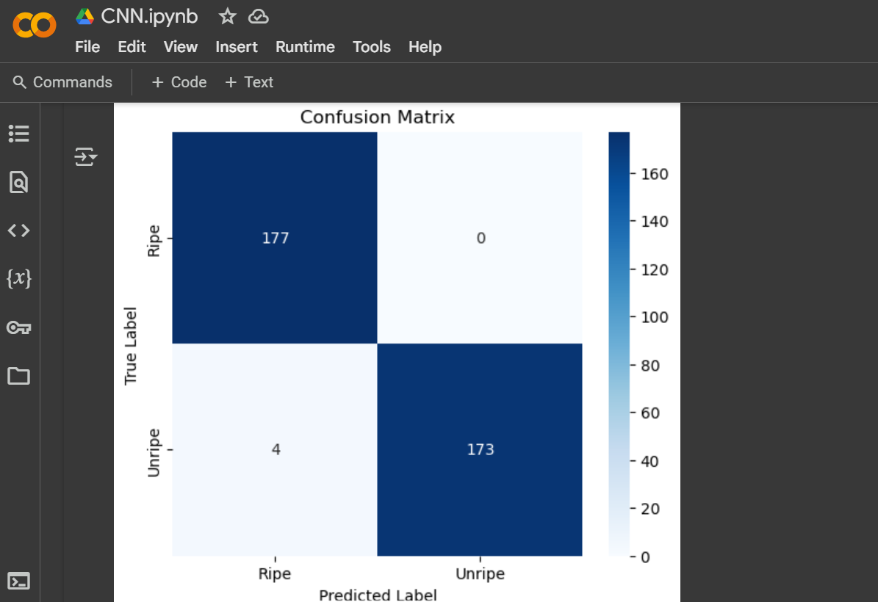
Evidences for the completion
CNN Confusion_metrix

Slide 28
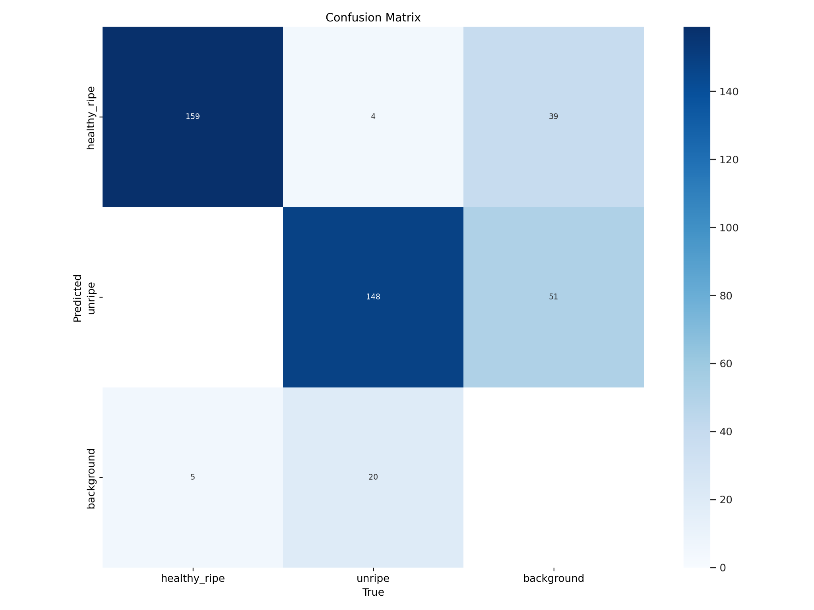
Evidences for the completion
Yolov8 Confusion_metrix

Slide 29
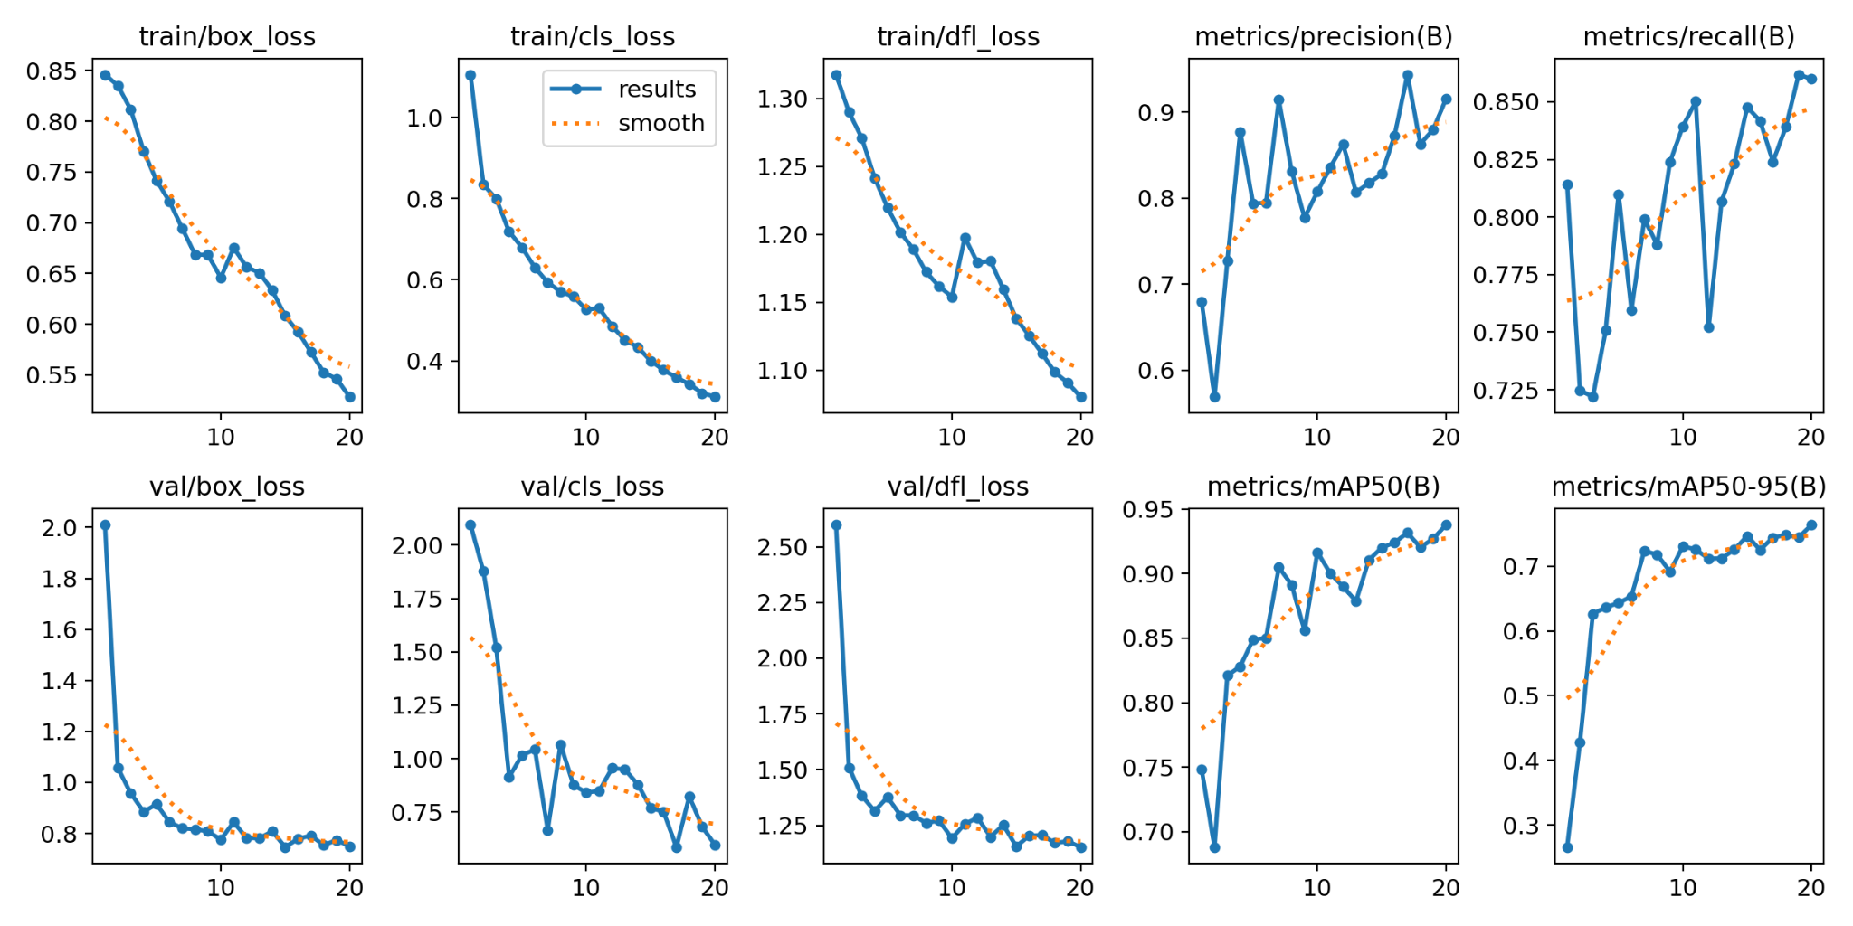
Evidences for the completion
Yolov8 results

Slide 30
Evidences for the completion
Sum of Diagonal Elements (Correct Predictions): 0.93+0.97+0.96+0.84=3.70.93 + 0.97 + 0.96 + 0.84 = 3.70.93+0.97+0.96+0.84=3.7
Total Sum of Matrix Elements: Since the matrix is normalized, this equals 4.0.
Accuracy Formula:
Accuracy = Sum of Diagonal Element
Total Sum of All Elements
Accuracy:
Accuracy = 3.7 = 0.935
4.0
= 93.5%
Accuracy calculation

Slide 31
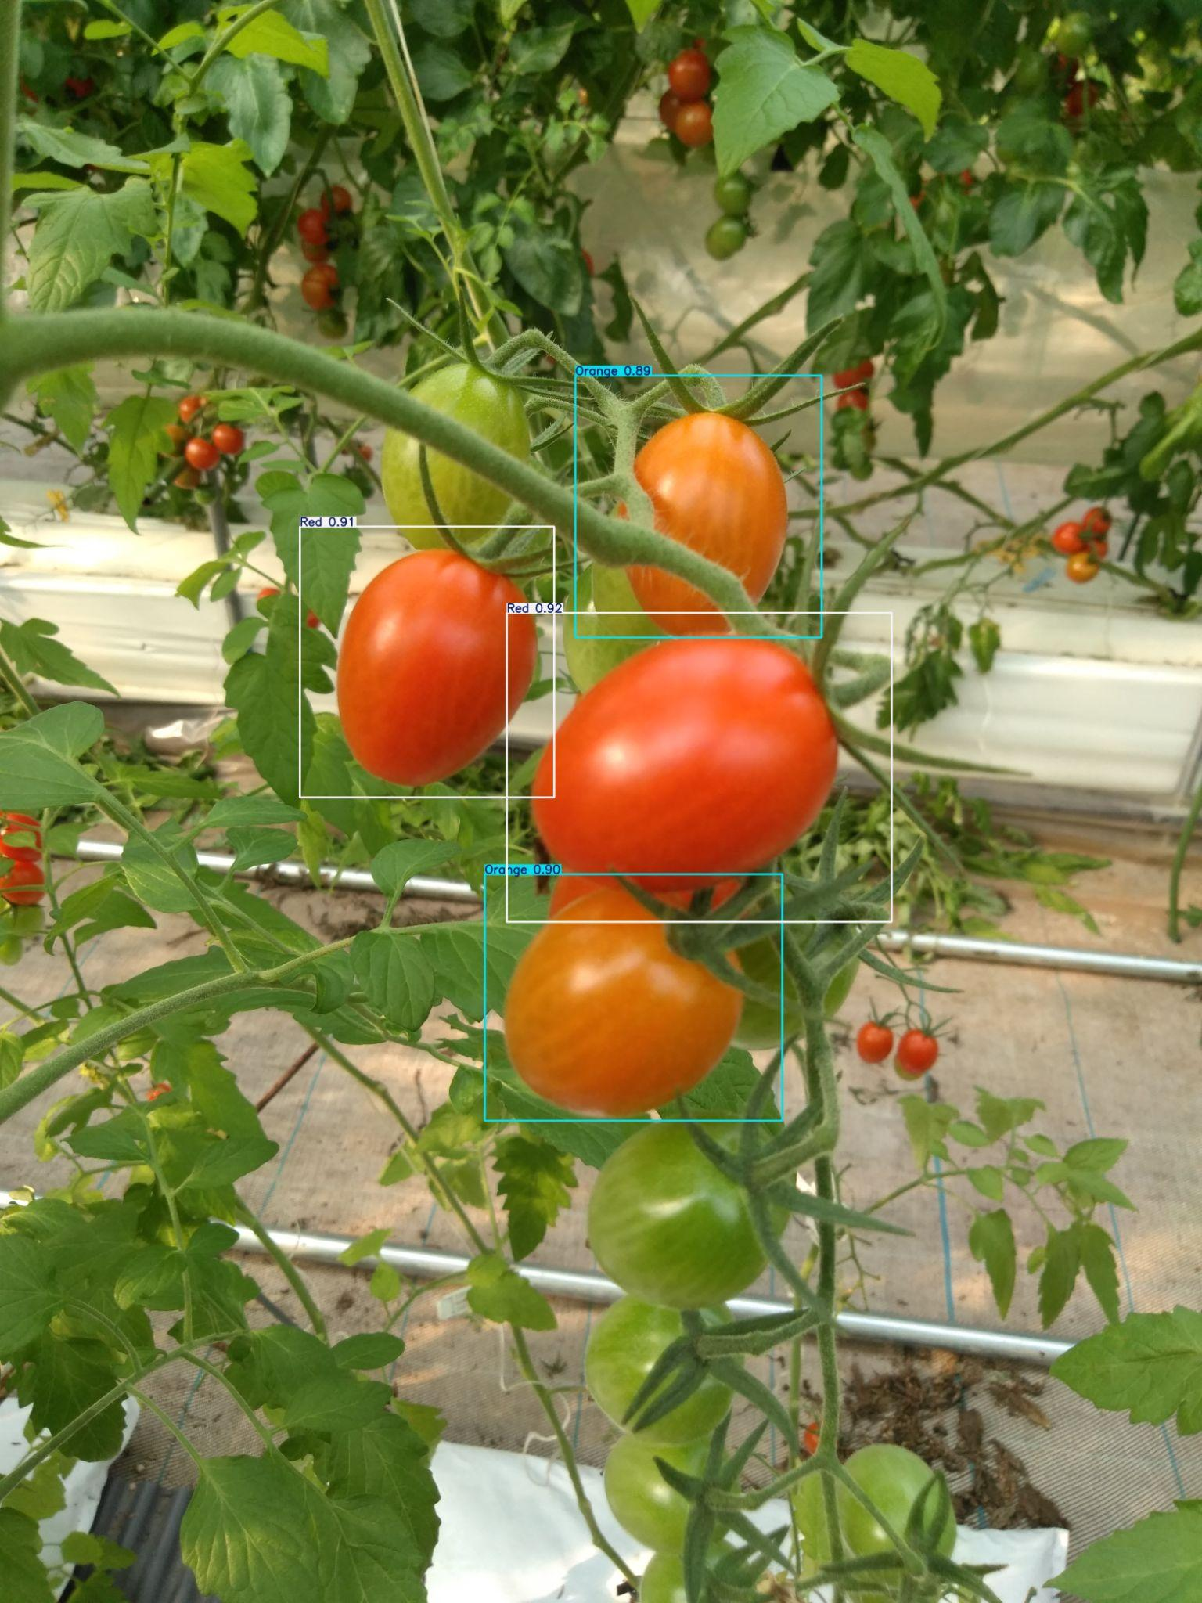
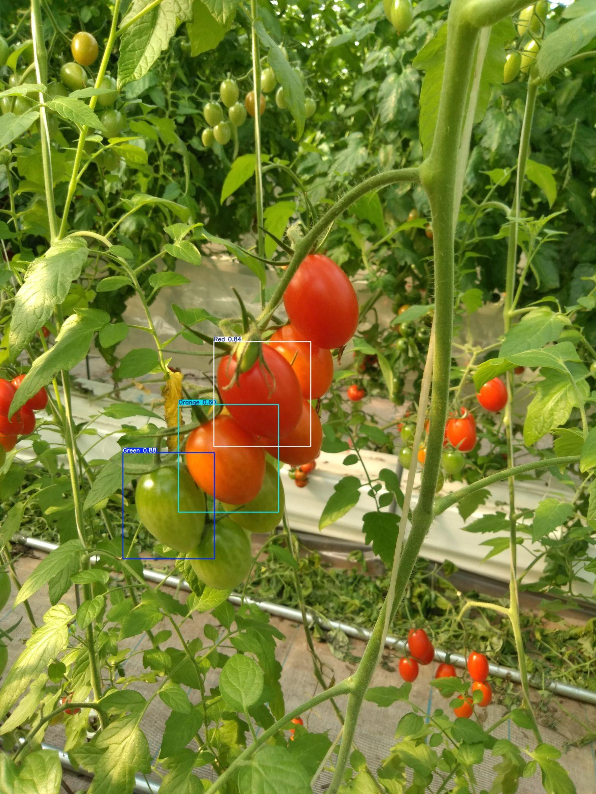
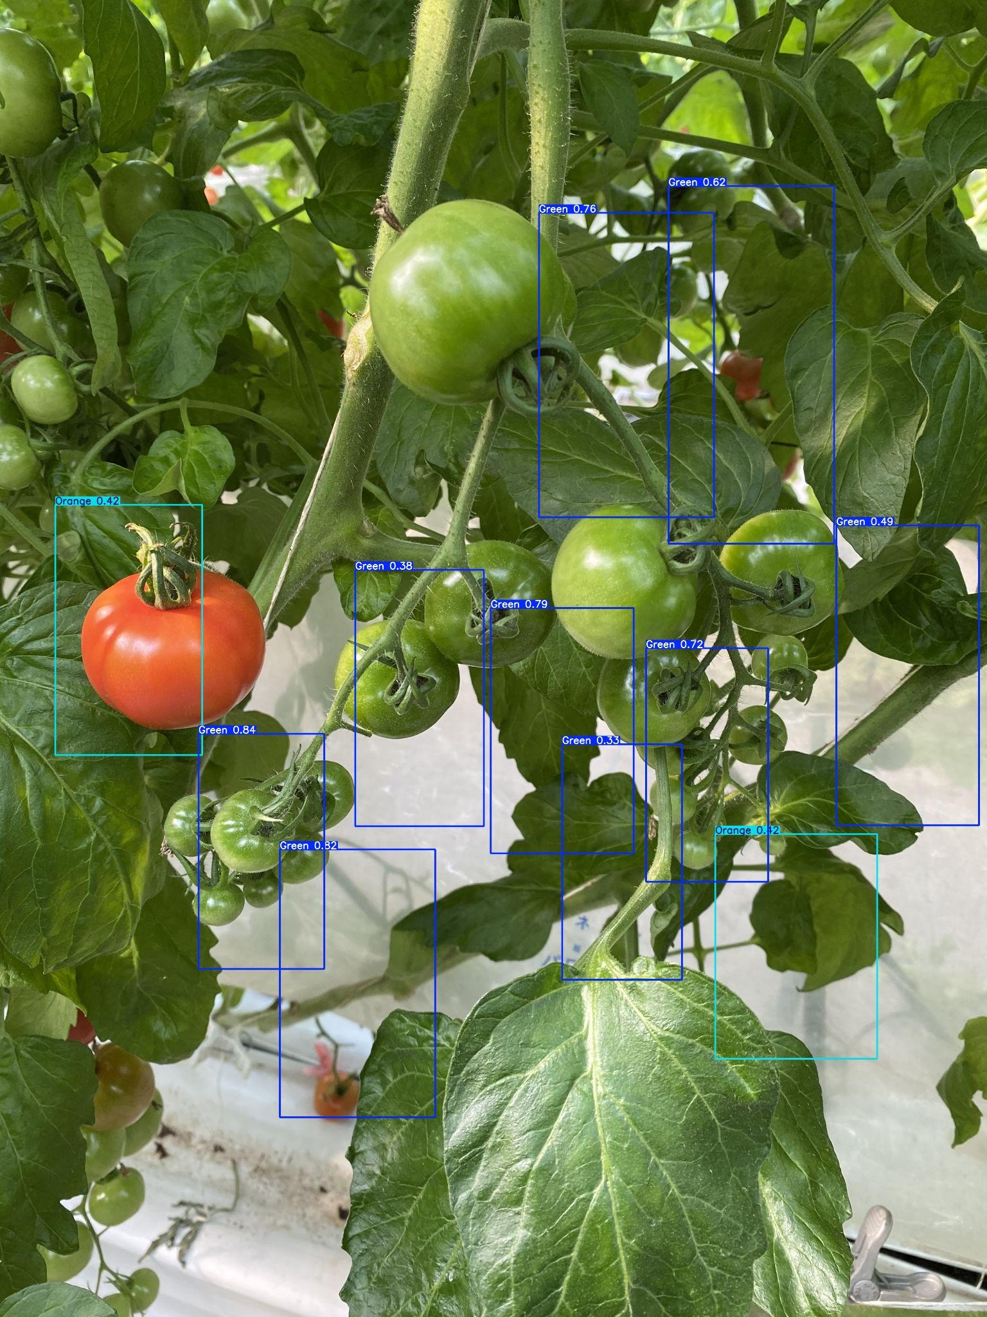
Evidences for the completion
Detected Value

Slide 32
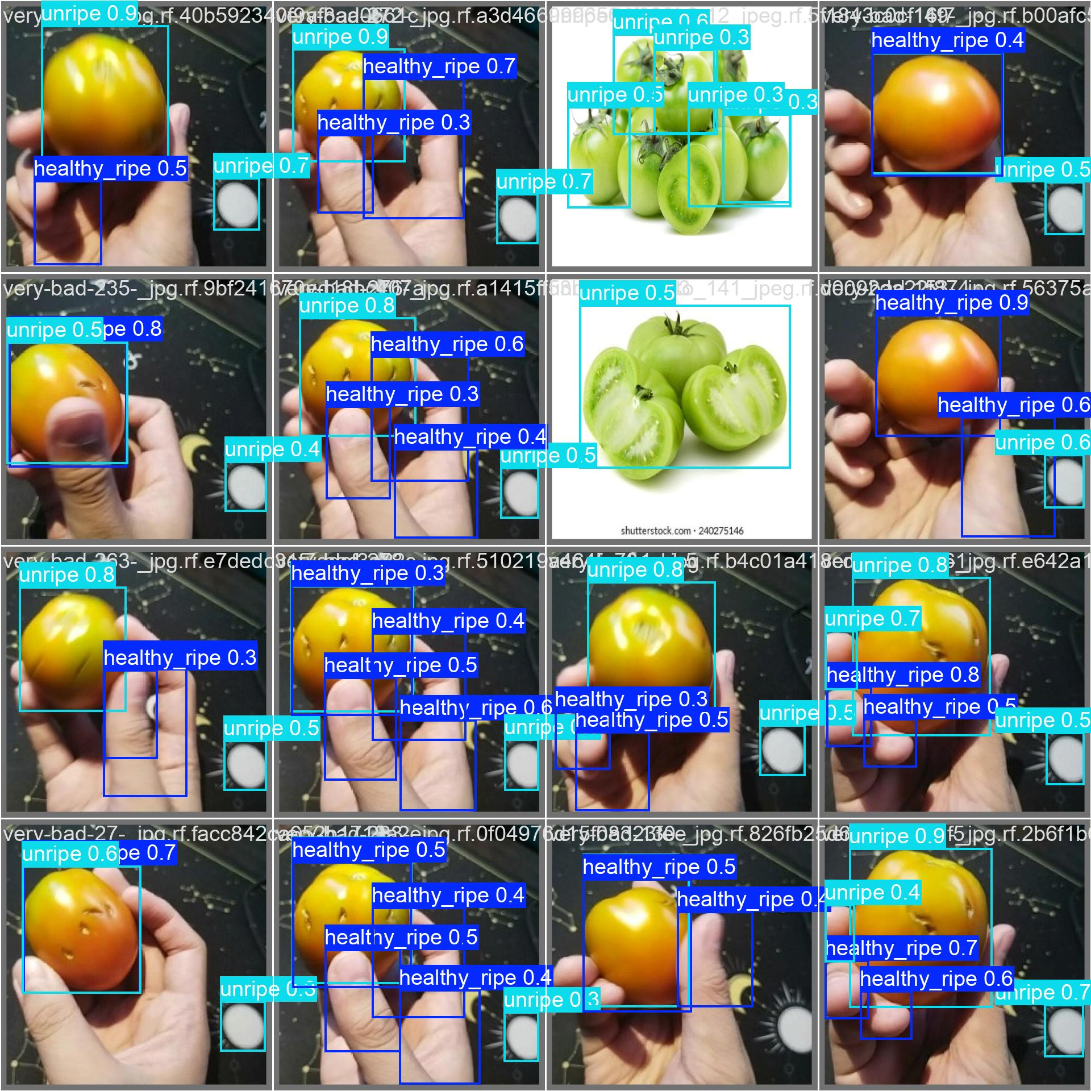
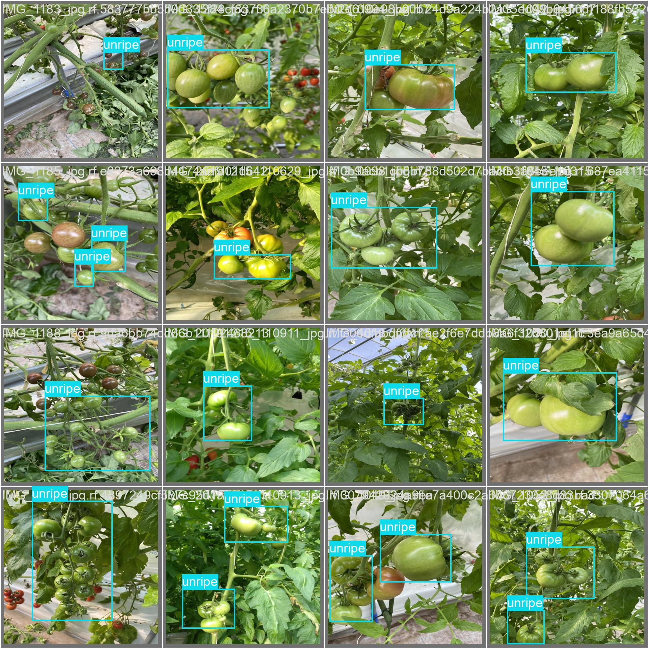
Evidences for the completion
Detected Value

Slide 33
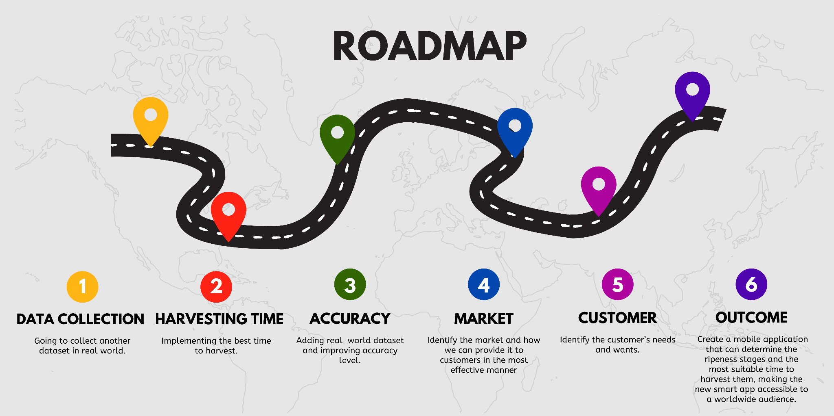
Tasks TO Do

Slide 34








Technologies
Mobile App
Image Recognition and Machine Learning
IT 21013164|Samarasinghe G.D.M.J| 24-25J-377

Slide 35
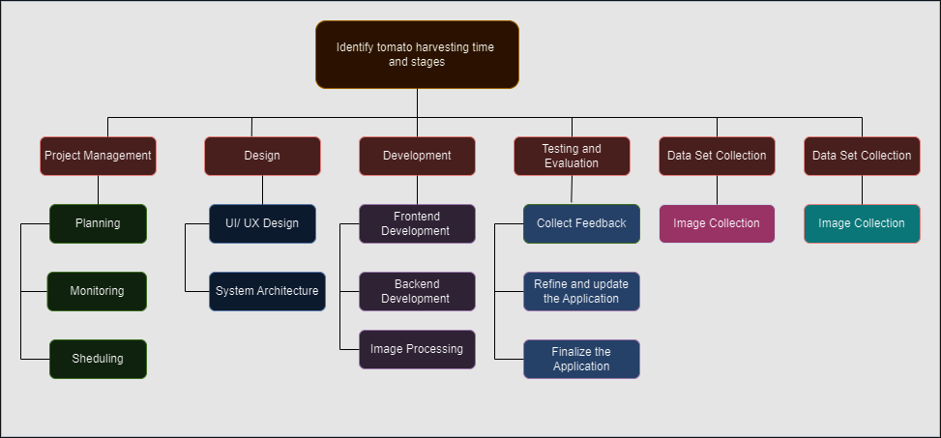
Work Breakdown
IT 21013164|Samarasinghe G.D.M.J| 24-25J-377

Slide 36
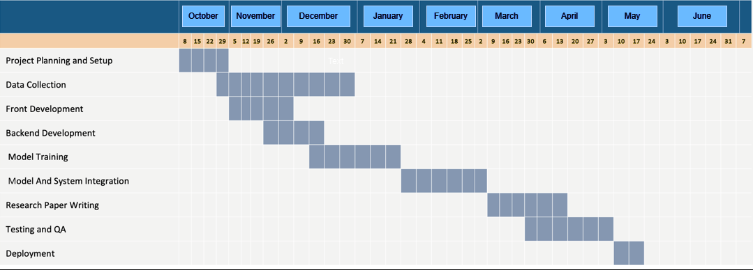
Gantt Chart
IT 21013164|Samarasinghe G.D.M.J| 24-25J-377

Slide 37
References
[1]“Reducing post-harvest losses in fruits and vegetables for ensuring food security – Case of Sri Lanka,” MOJ Food Processing & Technology, vol. Volume 9, no. Issue 1, Feb. 2021, doi: https://doi.org/10.15406/mojfpt.2021.09.00255.
[2]“VPN - Sri Lanka Institute of Information Technology,” Sliit.lk, 2024. https://vpn.sliit.lk/proxy/716c6bb7/https/ieeexplore.ieee.org/document/8574865 (accessed Oct. 14, 2024).
‌
[3]“Tomato sps 19_mag_00033,” SlideShare, 2021. https://www.slideshare.net/slideshow/tomato-sps-19mag00033/249728881#26 (accessed Oct. 10, 2024).
‌
[4]Y. H. Yap, “Tomato ripeness detection using deep learning - Universiti Teknologi Malaysia Institutional Repository,” Eprints.utm.my, 2022, doi: http://eprints.utm.my/99588/1/YapYoonHengMSKE2022.pdf.
‌[5]“VPN - Sri Lanka Institute of Information Technology,” Sliit.lk, 2024. https://vpn.sliit.lk/proxy/30dfd70f/https/ieeexplore.ieee.org/document/8489814/ (accessed Oct. 08 2024).
‌
IT 21013164|Samarasinghe G.D.M.J| 24-25J-377

Slide 38
IT 20665548|Herath H.M.R.K
BSc. (Hons) Degree in Information Technology Specialization in Information Technology
IT 20665548| H.M.R.K Herath| 24-25J-377

Slide 39
Research Gap
Manual grading is subjective and labor-intensive, while automated systems struggle with real-world conditions like lighting and subtle defects.
Solution:
AI-based models ensure precise detection, handle diverse conditions, and align with commercial standards.
IT 20665548| H.M.R.K Herath| 24-25J-377

Slide 40
Research Problem
How to develop an optimal solution for accurately distinguishing tomato defects from each other?
Evaluate the severity of detected defects for quality grading.
To what extent can tomato defects be identified and graded according to commercial standards using machine learning and image processing techniques?
IT 20665548| H.M.R.K Herath| 24-25J-377

Slide 41
Comparison
Manual Grading:
Subjective, labor-intensive, prone to inconsistencies and errors, and unsuitable for large-scale operations.
Automated Grading:
AI-driven, fast, objective, scalable, and robust in detecting subtle defects under varying conditions.
IT 20665548| H.M.R.K Herath| 24-25J-377

Slide 42
Specific and Sub Objectives
Primary Objective:
Develop an AI-driven system for tomato defect detection and quality grading.
Sub-Objectives:
Detect common defects: Fresh, unripe, cracks, shriveled, rotten, etc.
Classify tomatoes into grades: Grade A, B, C.
IT 20665548| H.M.R.K Herath| 24-25J-377

Slide 43
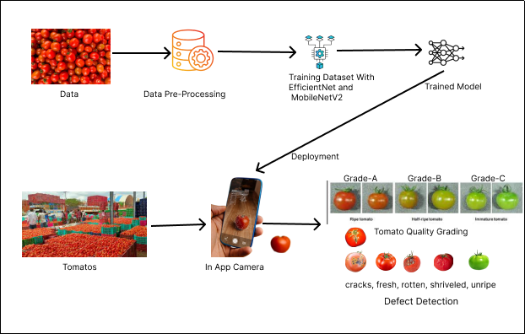
System Overview
IT 20665548| H.M.R.K Herath| 24-25J-377

Slide 44
Completed Tasks
Researched existing defect detection and quality grading methods.
Selected EfficientNet for defect detection and MobileNetV2 for grading.
Prepared and labeled datasets for both tasks.
Trained and validated defect detection and grading models.
Generated predictions for defects and grades on test images.

Slide 45
Completed Tasks
Developed application using Flutter
Developed Backend using Python (FastAPI)
Detect common defects: Fresh, unripe, cracks, shriveled, rotten, etc.
Generated predictions for defects and grades on test images.

Slide 46
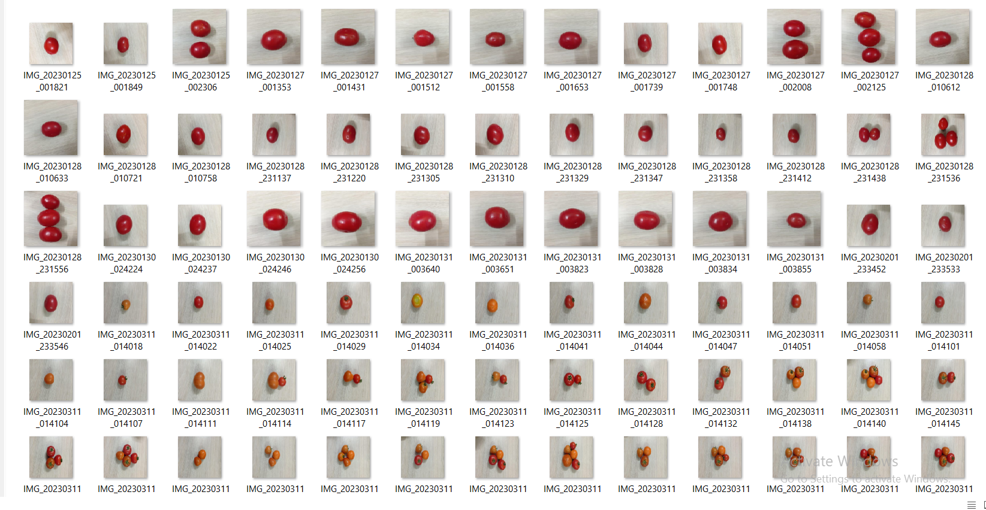
Dataset
Dataset

Slide 47
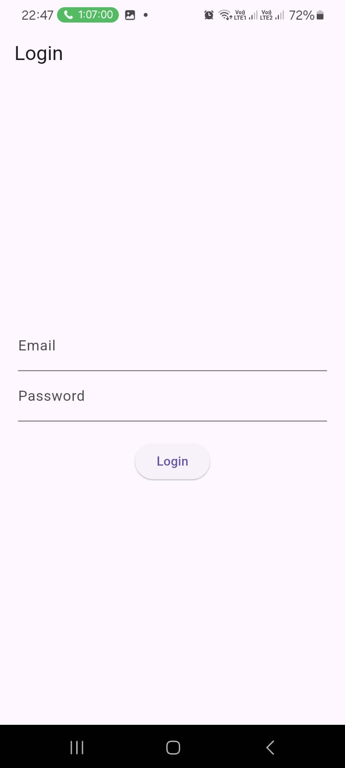
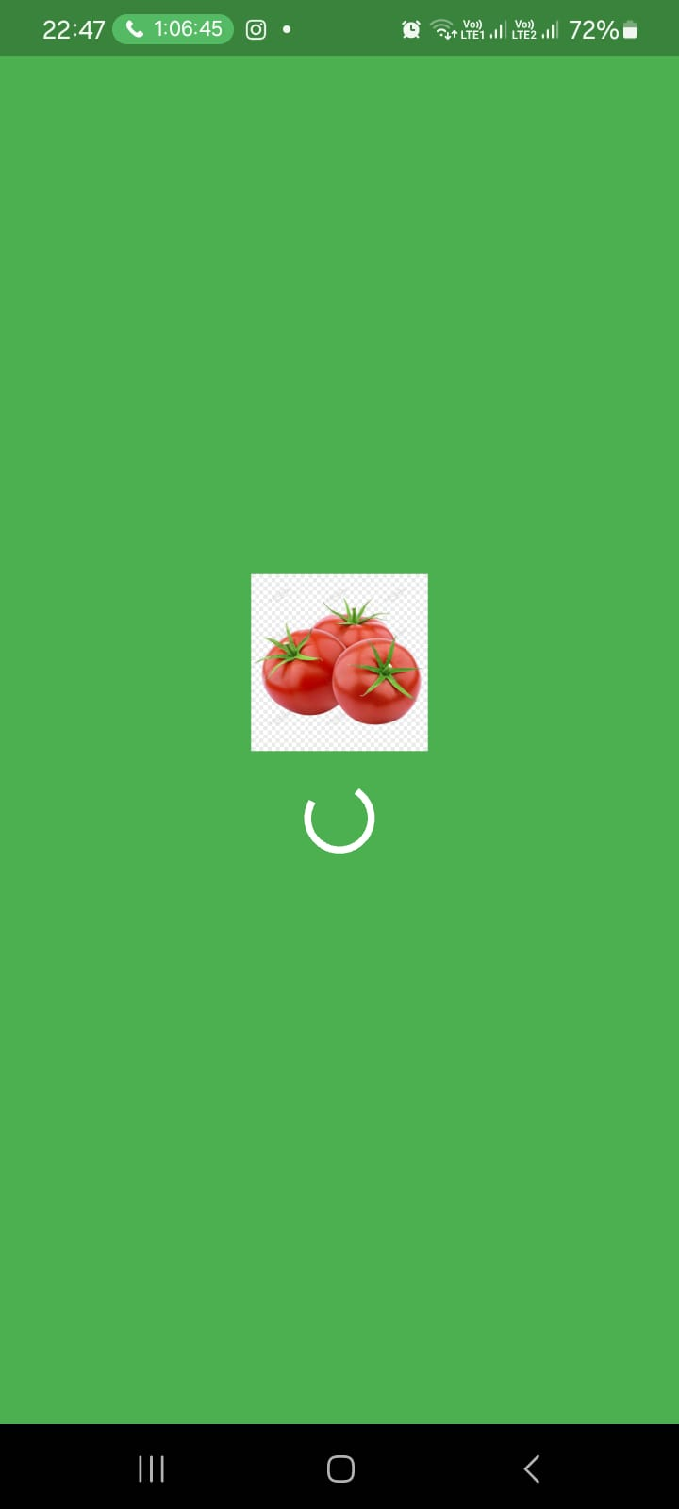
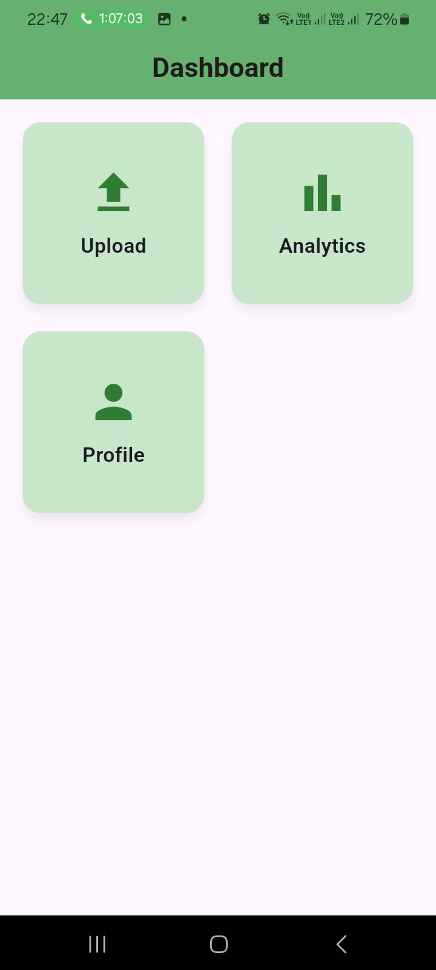
Evidences for the completion

Slide 48
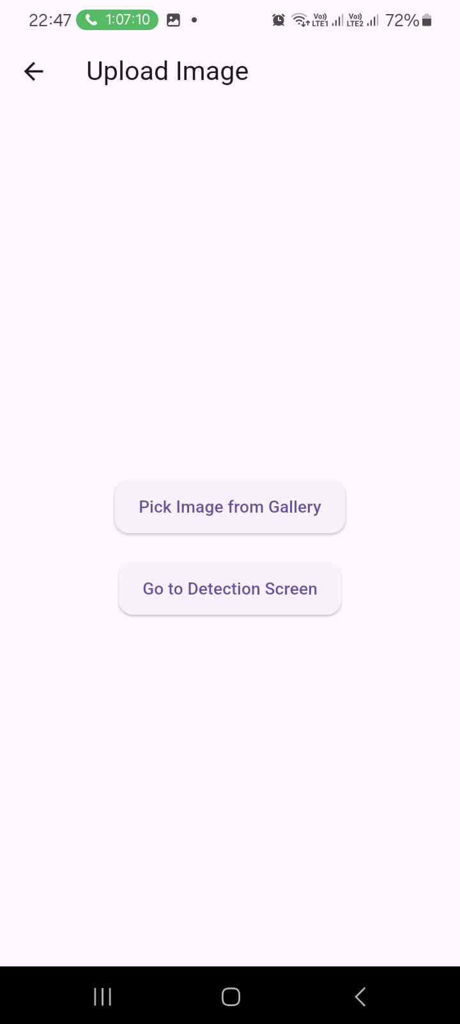
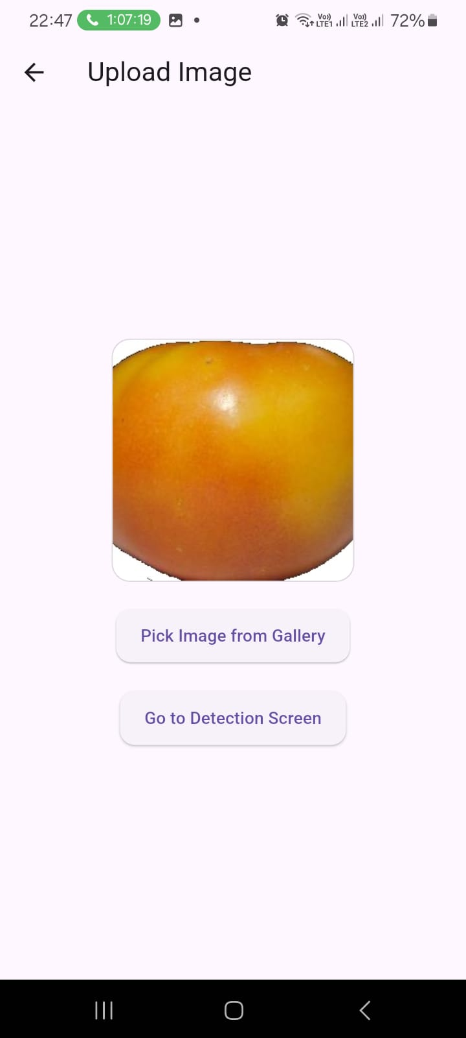
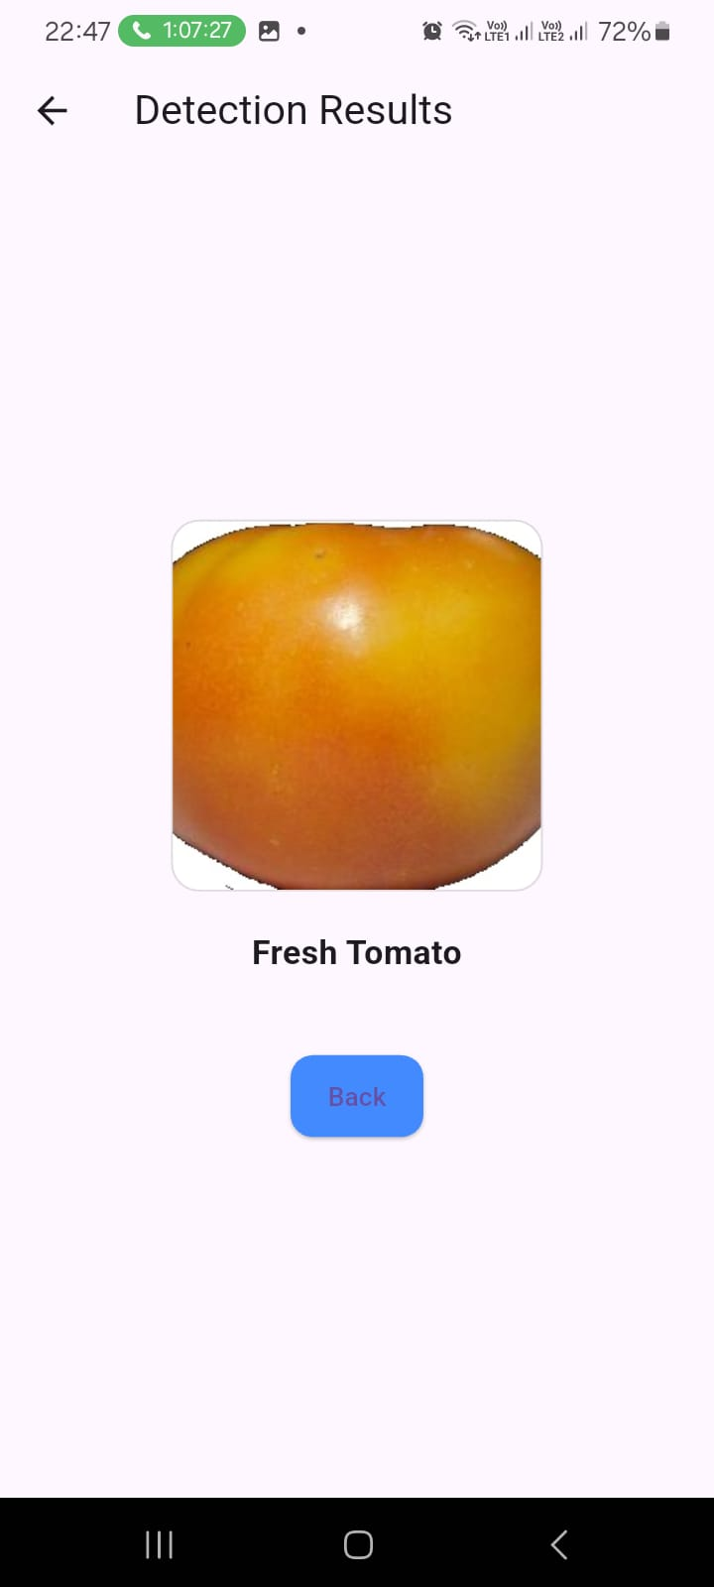
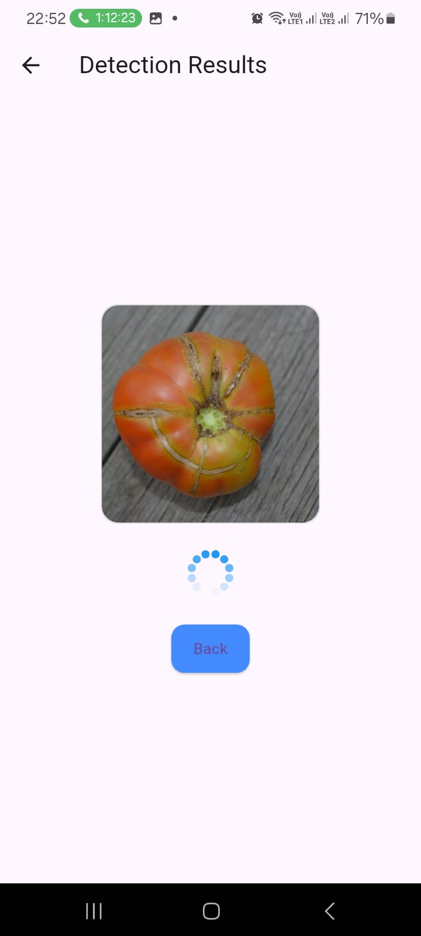
Evidences for the completion

Slide 49
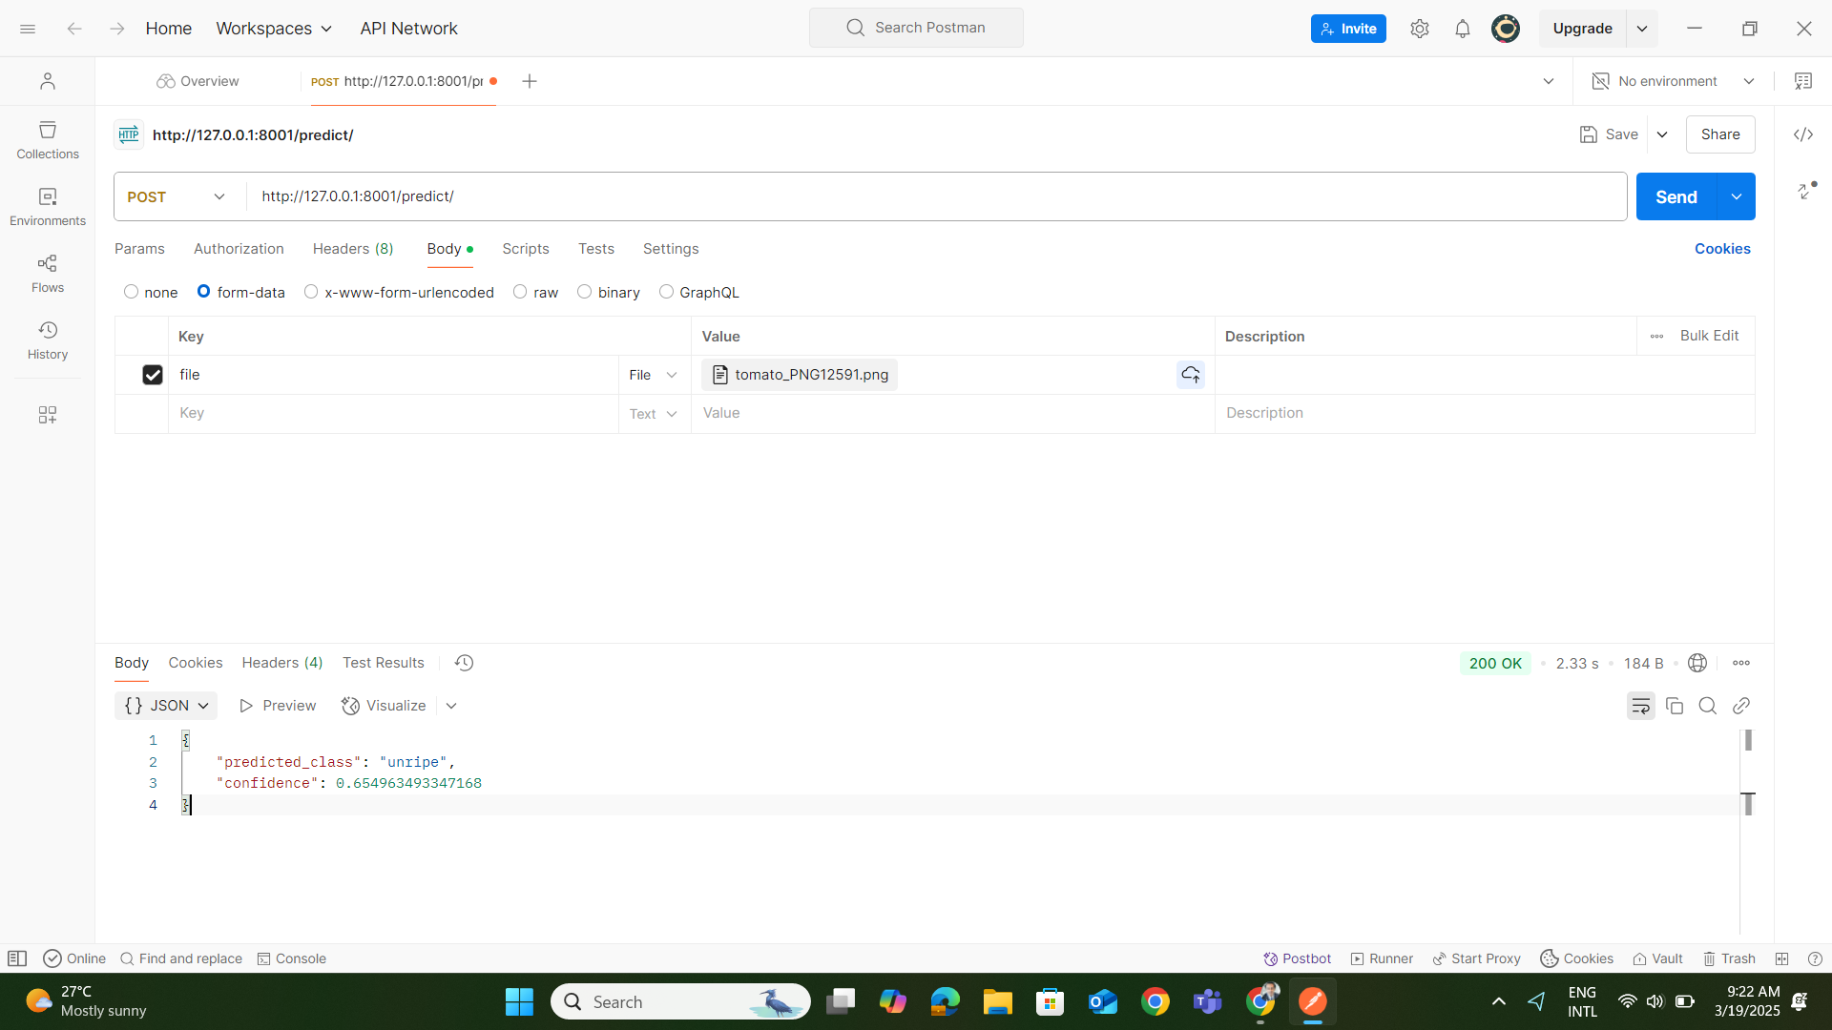
Evidences for the completion

Slide 50
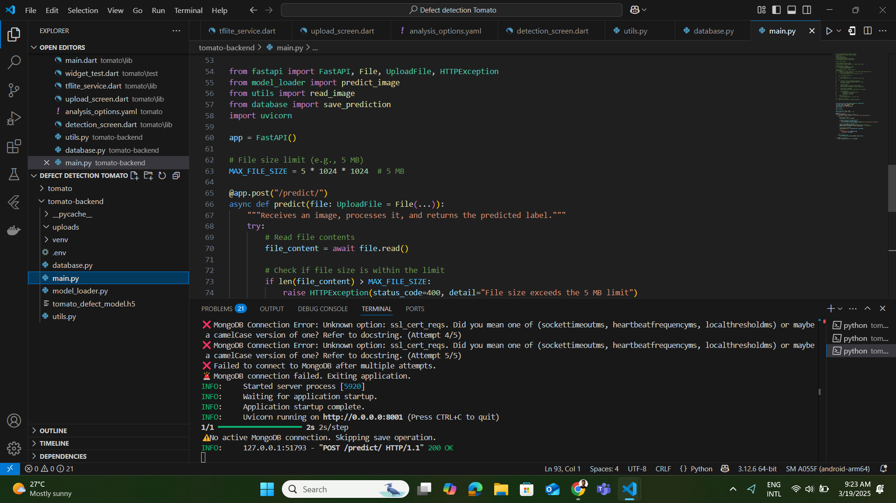
Evidences for the completion

Slide 51
Evidences for the completion

Slide 52
Tasks TO Do
Integrate Application
Finalize Grading model

Slide 53

Technologies
IT 20665548| H.M.R.K Herath| 24-25J-377

Slide 54

Work Breakdown
Defect Detection and Quality Grading
IT 20665548| H.M.R.K Herath| 24-25J-377

Slide 55

Gantt Chart
IT 20665548| H.M.R.K Herath| 24-25J-377

Slide 56
References
A microcontroller based machine vision approach for tomato grading and sorting using SVM classifier [https://www.sciencedirect.com/science/article/abs/pii/S0141933119307057]
Fruit-Based Tomato Grading System Using Features Fusion and Support Vector Machine [https://link.springer.com/chapter/10.1007/978-3-319-11310-4_35]
Computer Vision Based Fruit Grading System for Quality Evaluation of Tomato in Agriculture industry [ https://www.sciencedirect.com/science/article/pii/S1877050916001861 ]
A cost effective tomato maturity grading system using image processing for farmers [ https://ieeexplore.ieee.org/abstract/document/7019591 ]
IT 20665548| H.M.R.K Herath| 24-25J-377

Slide 57
IT 20142728| Ranawaka. T.D
BSc. (Hons) Degree in Information Technology Specialization in Information Technology
IT 20142728|Ranawaka. T. D| 24-25J-377

Slide 58
Research Gap
extensive research on tomato disease diagnosis, which mostly concentrates on human inspection and simple image processing techniques.
Traditional methods rely on farmers' eye inspection, which is error-prone and frequently causes delayed disease response.
While most current research focuses on specific illnesses, there are no complete solutions that combine automated, real-time disease detection and severity evaluation.
The suggested system addresses this gap by providing:
Image processing done automatically to identify diseases early.
Multiple tomato illnesses are identified in real time using machine learning algorithms.
The objectives of this approach are to decrease crop loss, enhance disease control, and give tomato growers a scalable tool.
IT 20142728|Ranawaka. T. D| 24-25J-377

Slide 59
Research Problem
How to find a optimum solution for identify diseases apart from each other accurately?
Evaluate the severity of identified disease ?
To what extent may early-stage tomato illnesses be identified using machine learning and image processing?
IT 20142728|Ranawaka. T. D| 24-25J-377

Slide 60
Specific and Sub Objectives
Improve Disease Detection and Management in Tomato Farming
Create an automated system that can identify and categorize tomato illnesses early on using machine learning and image processing.
Evaluate how well the system works to improve overall disease control for tomato growers and reduce crop loss.
IT 20142728|Ranawaka. T. D| 24-25J-377

Slide 61
Sub Objectives
Design and Development of the Disease Detection System
Testing and Validation of the Disease Detection System
Mobile Application Integration
Real-Time Decision Support for Farmers
IT 20142728|Ranawaka. T. D| 24-25J-377

Slide 62






System Overview
ISP
Flask
Backend
user interface
My component
IT 20142728|Ranawaka. T. D| 24-25J-377

Slide 63
Completed Tasks
understanding the sub components.
find proper datasets
Study about ML models suitable
Augmente dataset
Train models using datasets
Fine tune and add to the flask server
build the pipline
IT 20142728|Ranawaka. T. D| 24-25J-377

Slide 64
In progress Tasks
Annotating a dataset for train a severity identification model using YOLO.
Design UI elements for mobile app
Finalizing models.
IT 20142728|Ranawaka. T. D| 24-25J-377

Slide 65
Tasks to DO
Implement React mobile app for the frontend.
Integrate all components.
Host the backend server in cloud platform.
IT 20142728|Ranawaka. T. D| 24-25J-377

Slide 66

Implementation
Train the model
IT 20142728|Ranawaka. T. D| 24-25J-377

Slide 67

Implementation
Fine tune the model
IT 20142728|Ranawaka. T. D| 24-25J-377

Slide 68

Implementation
Testing the model
IT 20142728|Ranawaka. T. D| 24-25J-377

Slide 69

Implementation
Testing the model
IT 20142728|Ranawaka. T. D| 24-25J-377

Slide 70

Evidence of completion
IT 20142728|Ranawaka. T. D| 24-25J-377

Slide 71

Evidence of completion
IT 20142728|Ranawaka. T. D| 24-25J-377

Slide 72

Evidence of completion
IT 20142728|Ranawaka. T. D| 24-25J-377

Slide 73

Evidence of completion
IT 20142728|Ranawaka. T. D| 24-25J-377

Slide 74

Implementation
IT 20142728|Ranawaka. T. D| 24-25J-377

Slide 75

Implementation
IT 20142728|Ranawaka. T. D| 24-25J-377

Slide 76
Implementation
Train the model
IT 20142728|Ranawaka. T. D| 24-25J-377

Slide 77

Technologies
IT 20142728|Ranawaka. T. D| 24-25J-377

Slide 78

Work Breakdown
IT 20142728|Ranawaka. T. D| 24-25J-377

Slide 79

Gantt Chart
IT 20142728|Ranawaka. T. D| 24-25J-377

Slide 80
References
https://www.sciencedirect.com/science/article/pii/S0168169920302052
https://www.sciencedirect.com/science/article/pii/S1877050920306906
https://plantmethods.biomedcentral.com/articles/10.1186/s13007-024-01188-1
IT 20142728|Ranawaka. T. D| 24-25J-377

Slide 81
Commercialization
Offer 6 months as a free application for the tomato cultivators. During that time we can improve the system according to the feedback of users. After 6 months we deploy the stable version with monthly 2$ subscription. Application will build as a cross platform application.

Slide 82
Budget
Description
fee(Rs)
Field visit
3000
AWS server usage
300
Datasets
2000
Total
5300

Slide 83
Thank You!

